Slide 1
Introduction Typescript
Why write Typescript when you can write Javascript?
Why learn a new language?

Slide 2

Notes:
If you have written a lot of JS you know it becomes messy if you don’t following certain patterns and practices like module pattern, prototype pattern etc. It leads to lack of maintainability and lack of reuse.

Slide 3

Notes:
Typescript can help you write clean, reusable code. Typescript is not the only way you can achieve clean and reusable code but it certainly is one of the best approaches to do that.

Slide 4
Javascript Dynamic Types
Javascript provides dynamic type system
The Good
Variables can hold any object (Boolean, string, number, object literal)
Types determined on the fly
Implicit type coercion (e.g. string to number)
The Bad
Difficult to ensure proper types are passed without tests
Not all developers use ===
Enterprise-scale apps can have 1000s of lines of code
Notes:
With implicit type coercion you can write code like if(1 == “1”) and it will work. But sometimes you don’t want to do that.
It is difficult to ensure that correct types are being passed from one part of code to other part of code without unit tests.
=== does not do type coercion so if you write code if(1 === “1”) it wont return true if types are different.

Slide 5
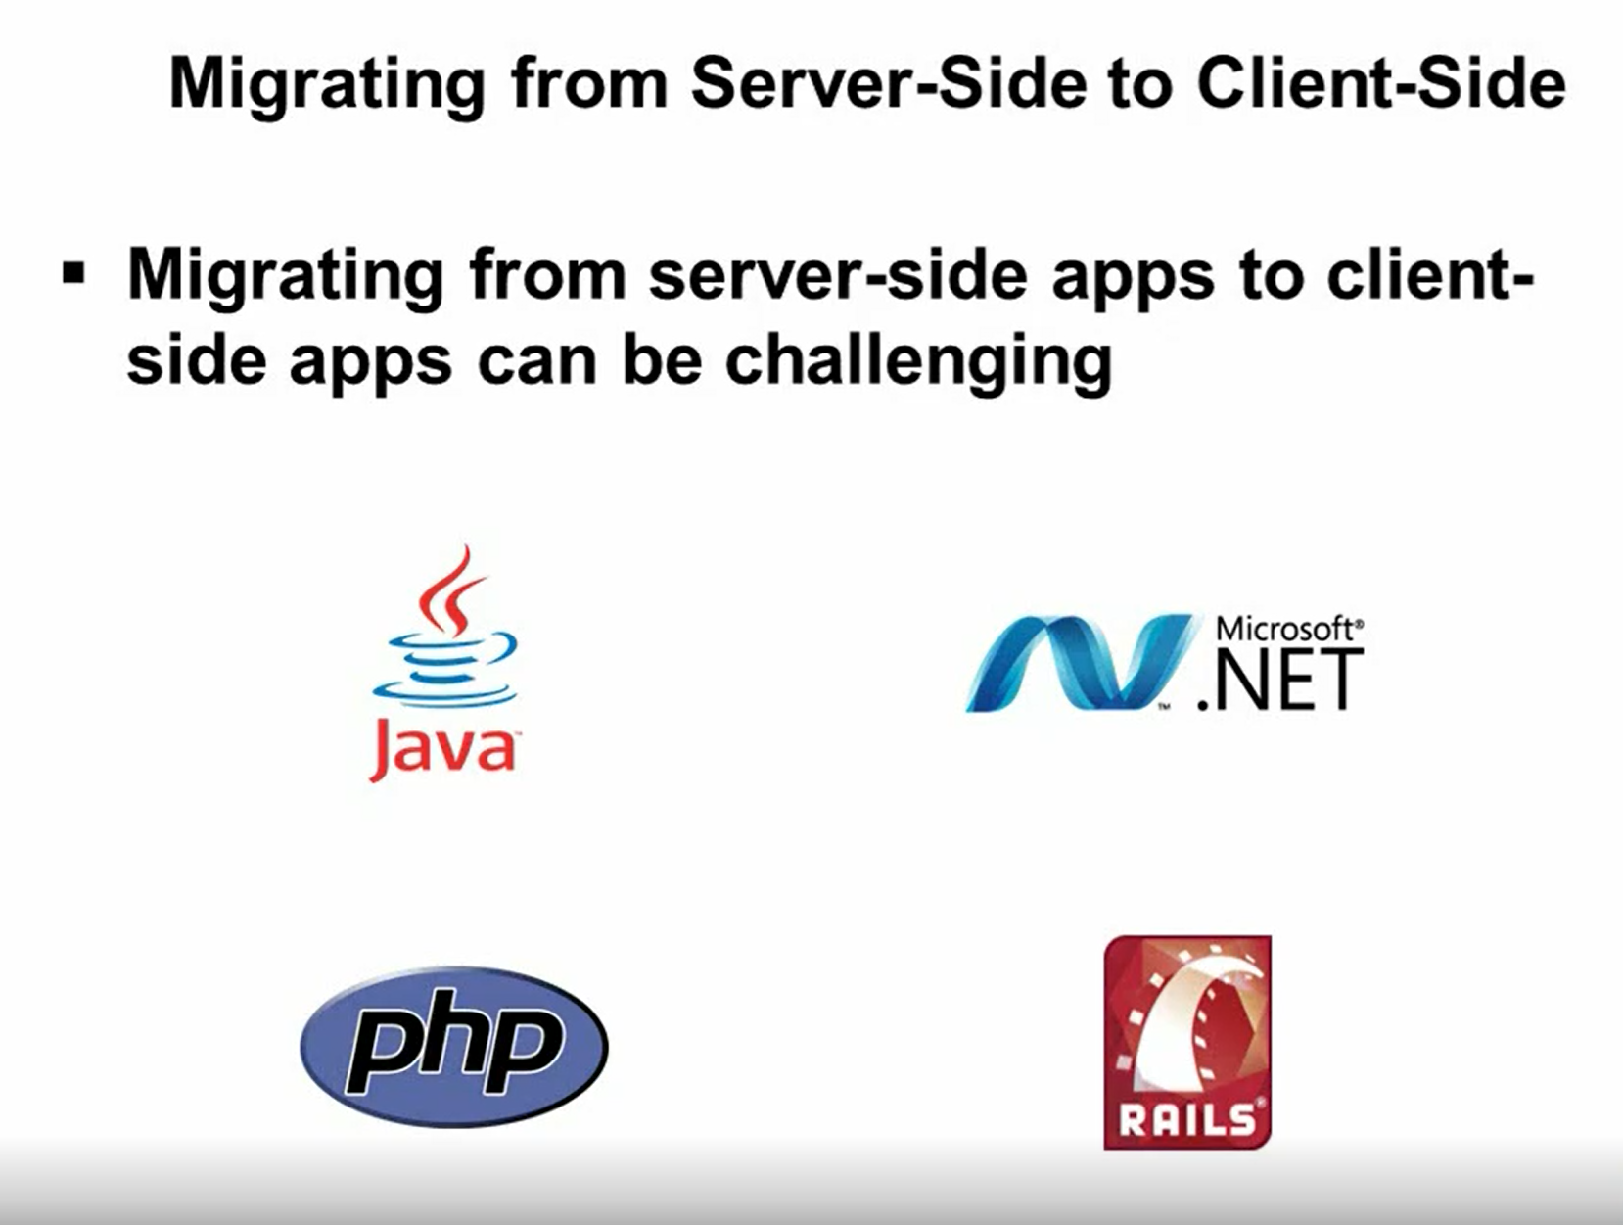

Slide 6
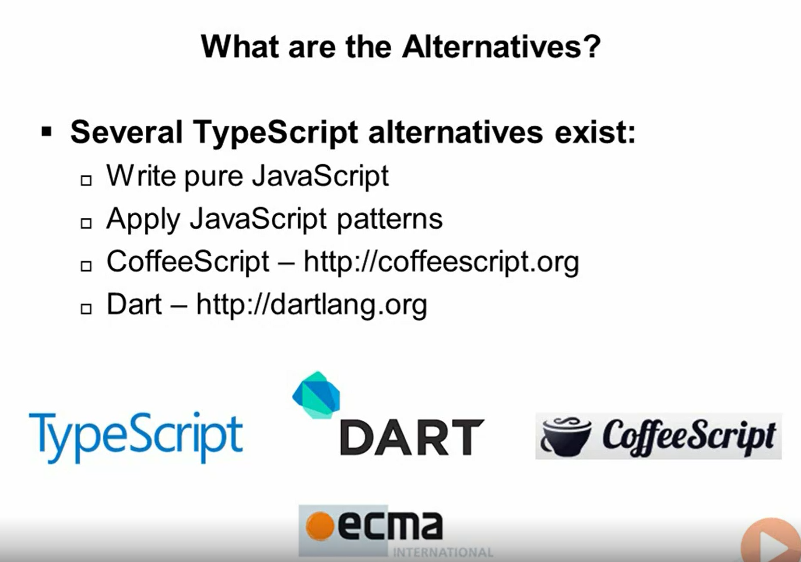

Slide 7
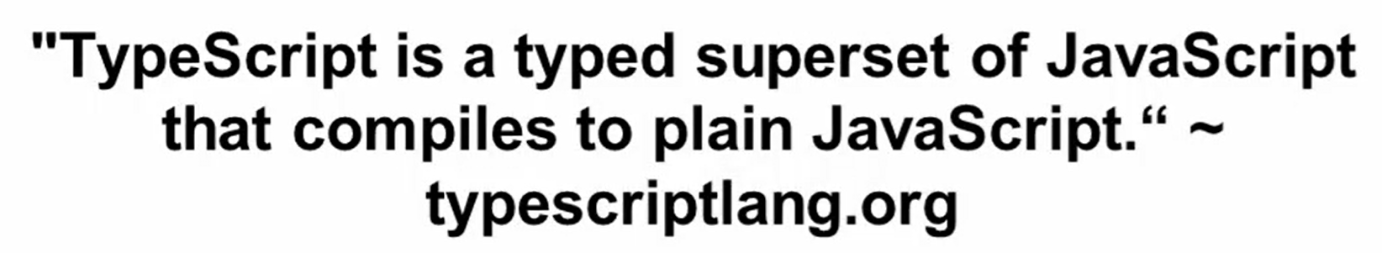
Typescript - Features

Slide 8
Flexible Options
Any browser
Any OS
Open Source
Tool Support

Slide 9
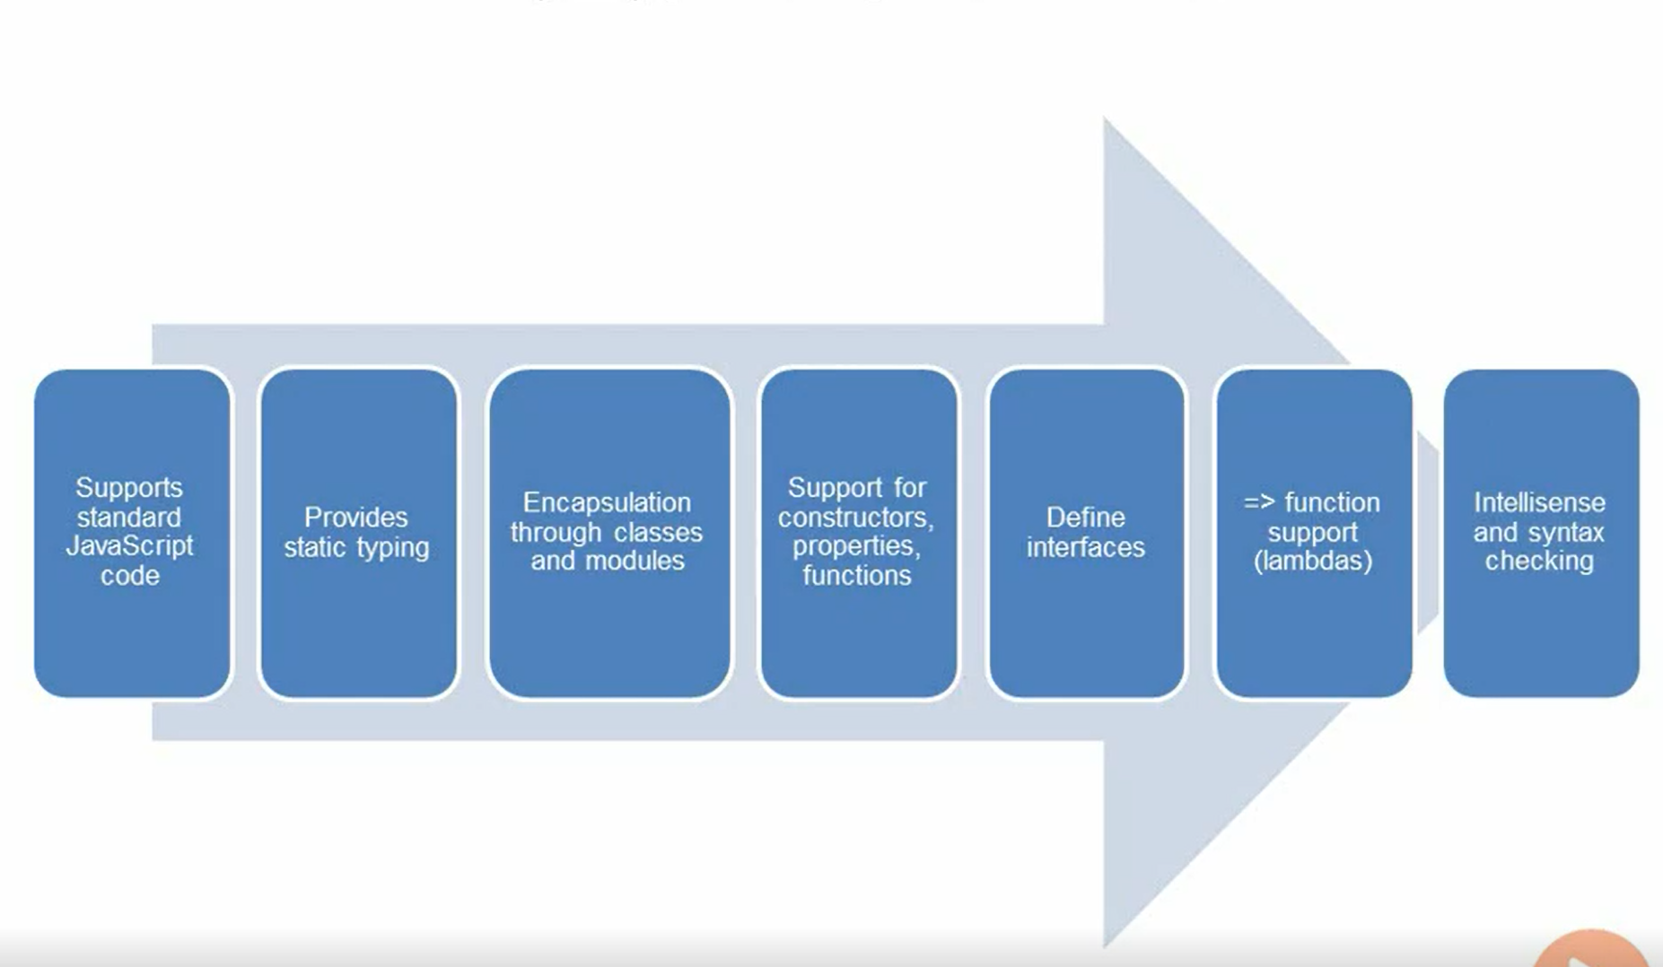
Key Typescript Features

Slide 10
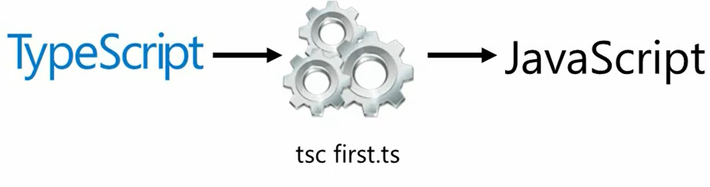
Typescript Compiler

Slide 11
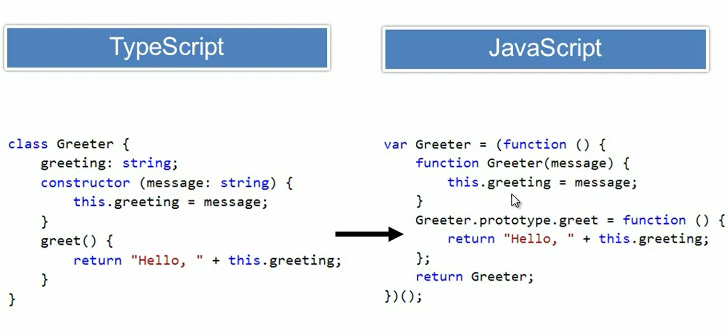

Slide 12
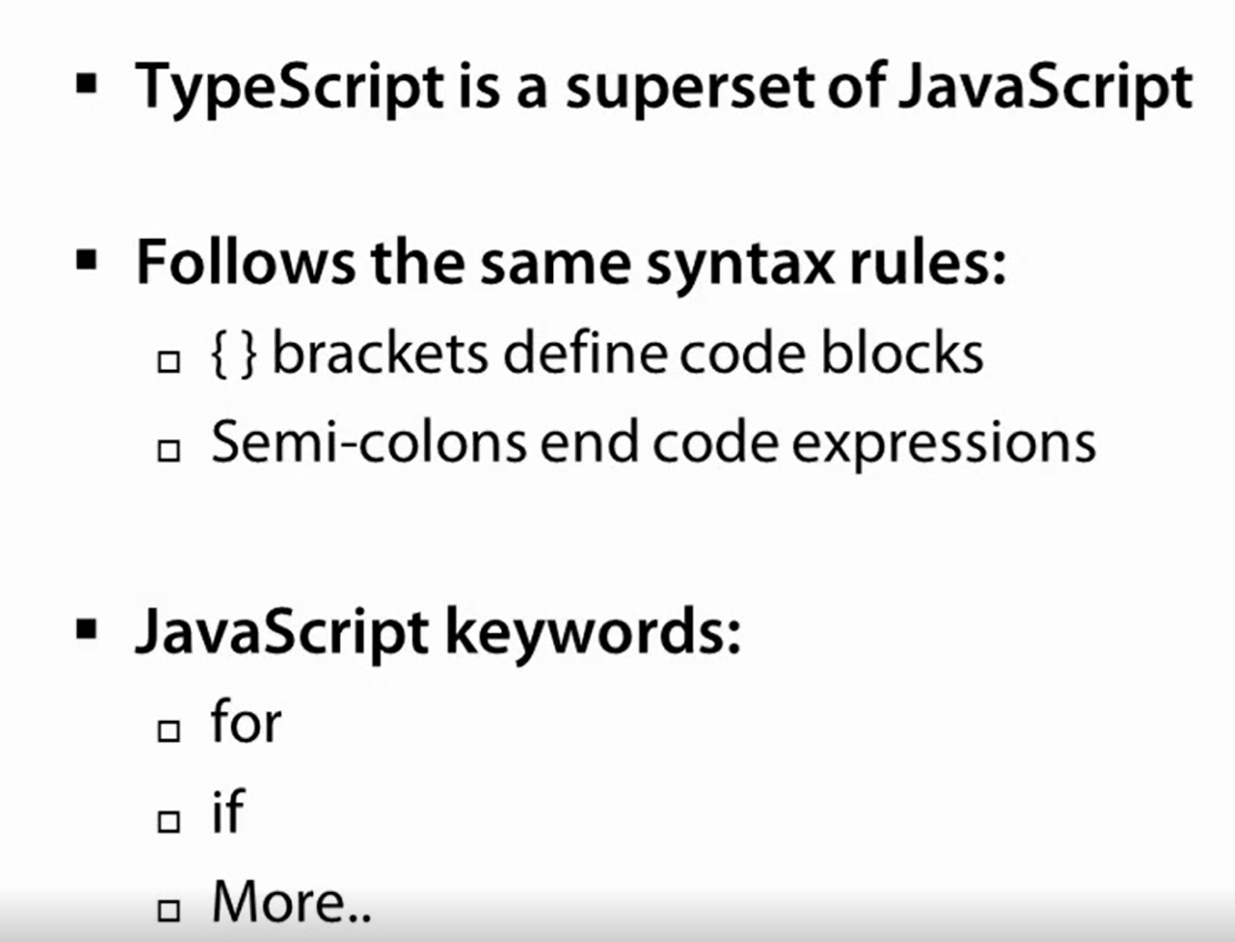
Typescript Syntax Rules

Slide 13
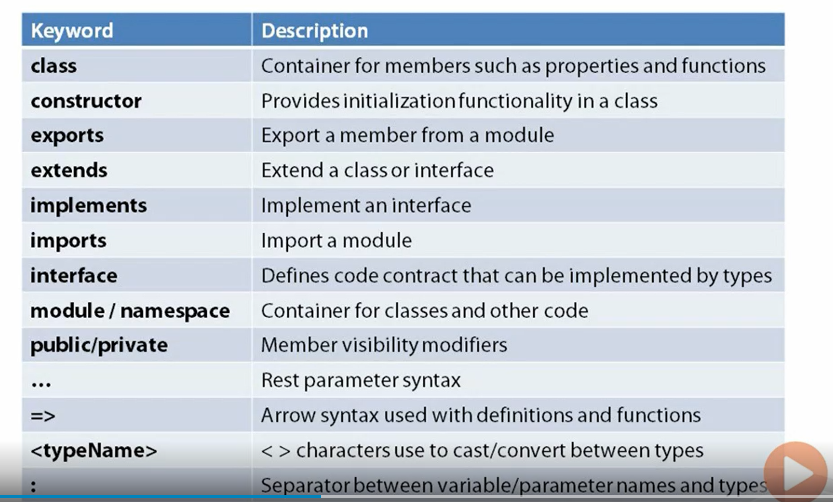
Important Keywords

Slide 14
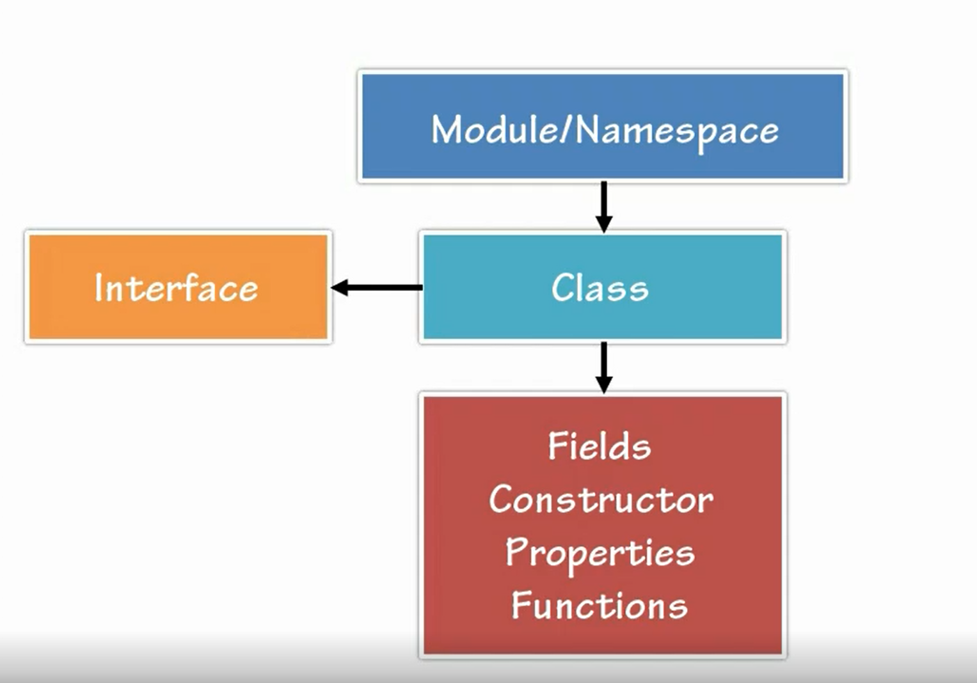
Code Hierarchy

Slide 15
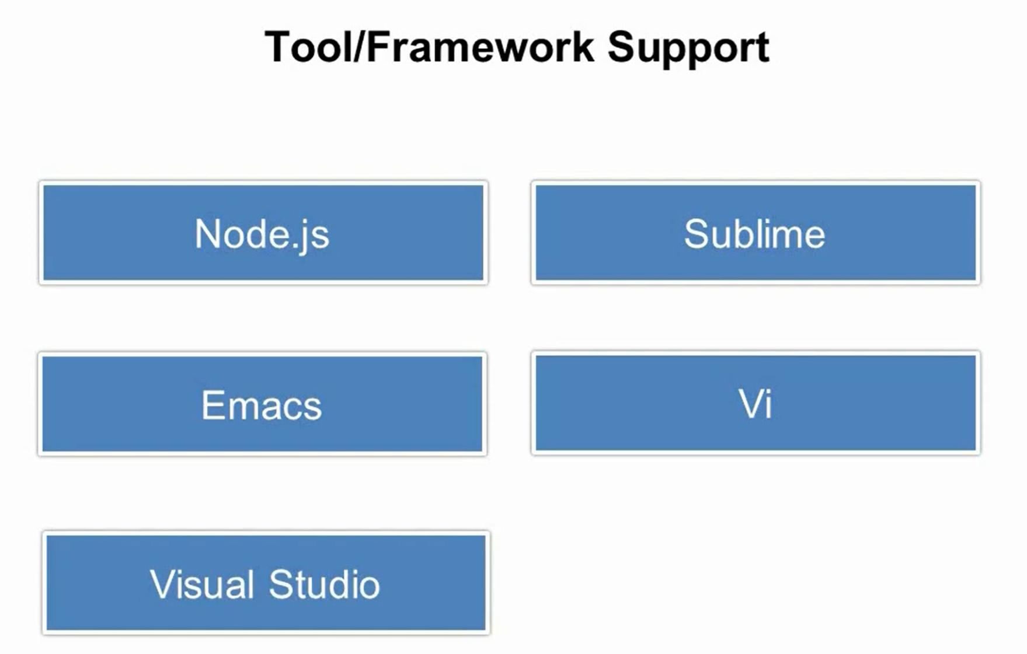
Notes:
http://fiddlesalad.com/typescript/

Slide 16
Typescript Compilation using tsc.exe
Some code editors like Visual Studio provide Typescript complication OOB
But if you are writing code against node.js you might want to compile your Typescript to Javascript as part of build process
So how to achieve it?

Slide 17
HelloWorld Demo
Create a ASP.Net Core “Web Application” type project.
Create an Engine class in Typescript file with start and stop methods.
Create an object of Engine class on window.onload method and call start and stop method.
Refer the generated JS in a HTML page.
Browse the page in a Browser.

Slide 18

Typing, Variables and Functions
Notes:
We will talk about core features of Typescript. It will jump start into things like grammar and syntax etc. We will cover primit

Slide 19
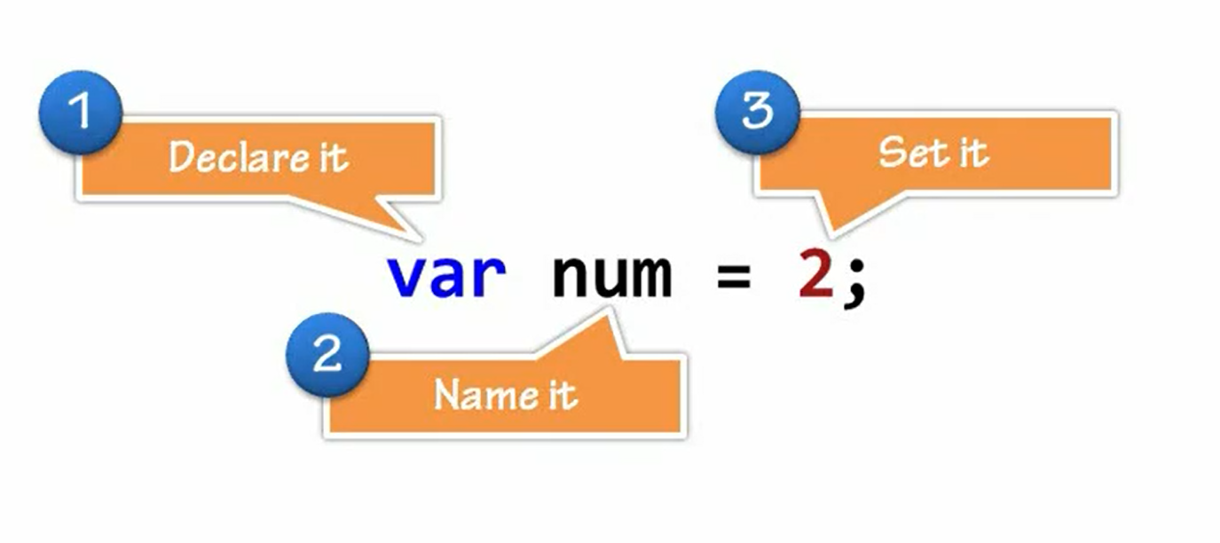
Grammar, Declarations and Annotations

Slide 20
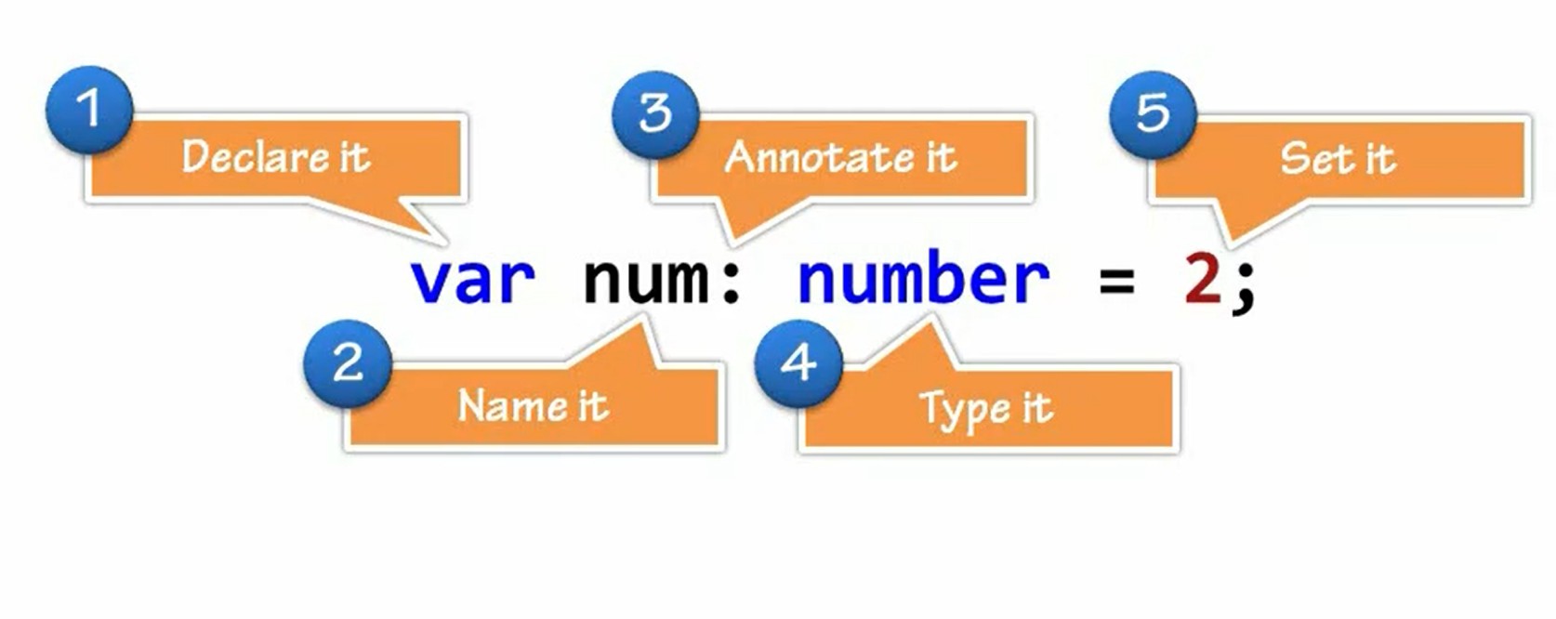
Type Annotations

Slide 21
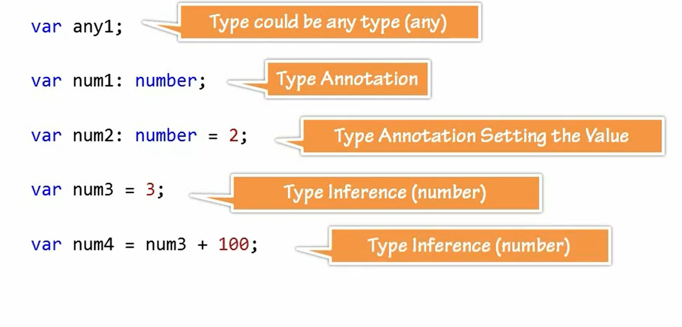
Annotation and Inferences
Notes:
Recommendation is to use line number 2.

Slide 22
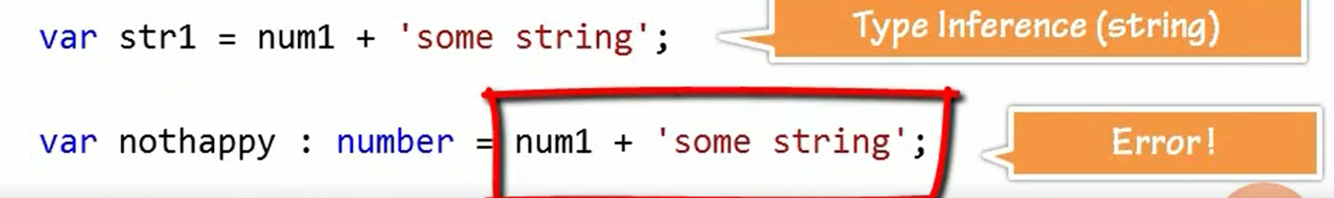
Annotation and Inferences

Slide 23
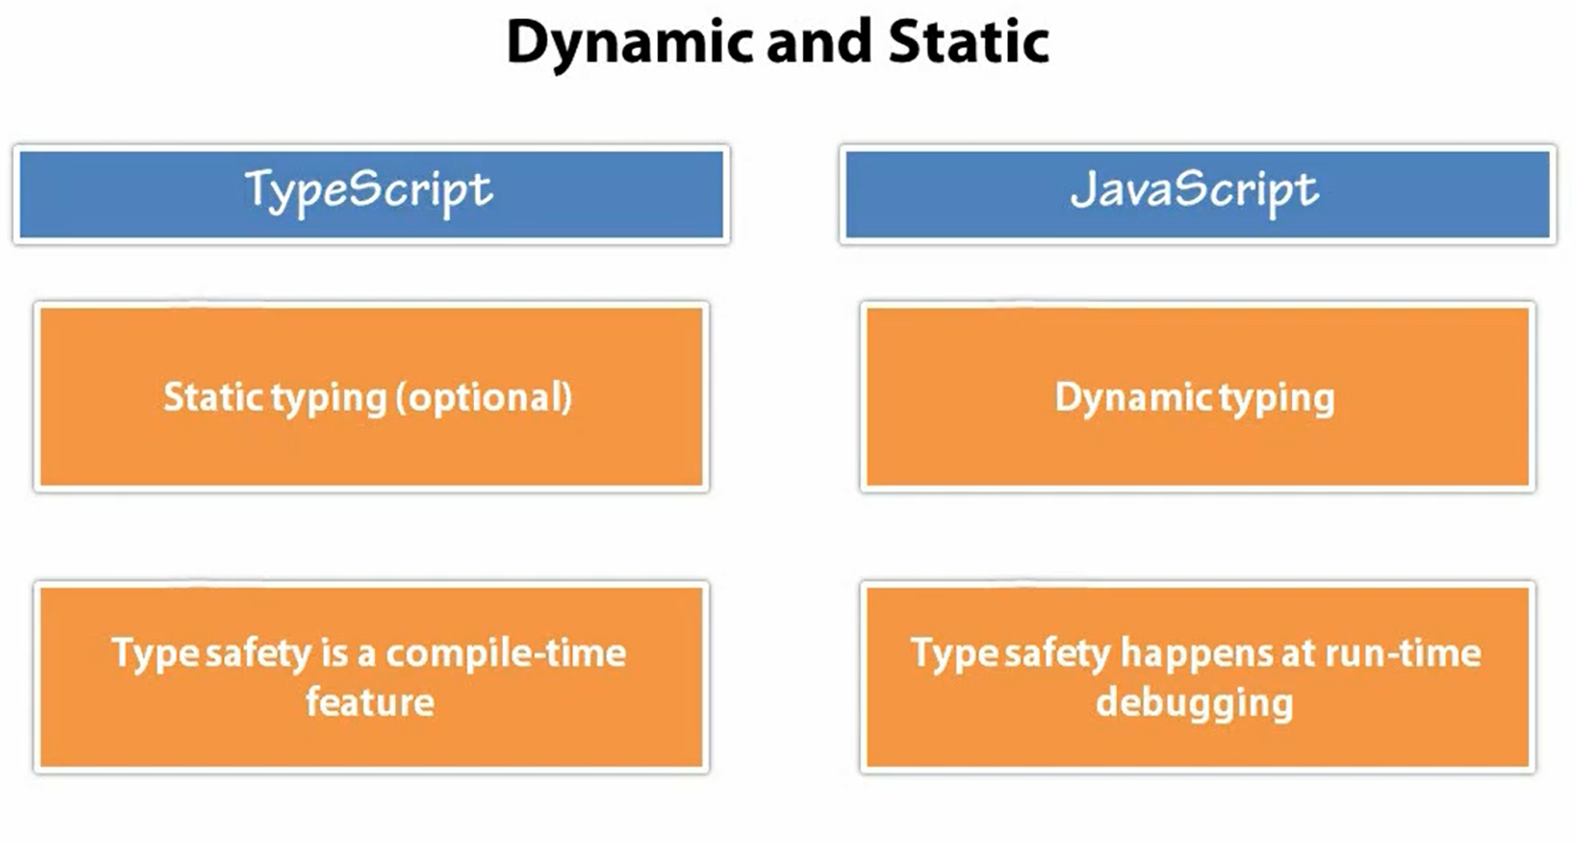

Slide 24
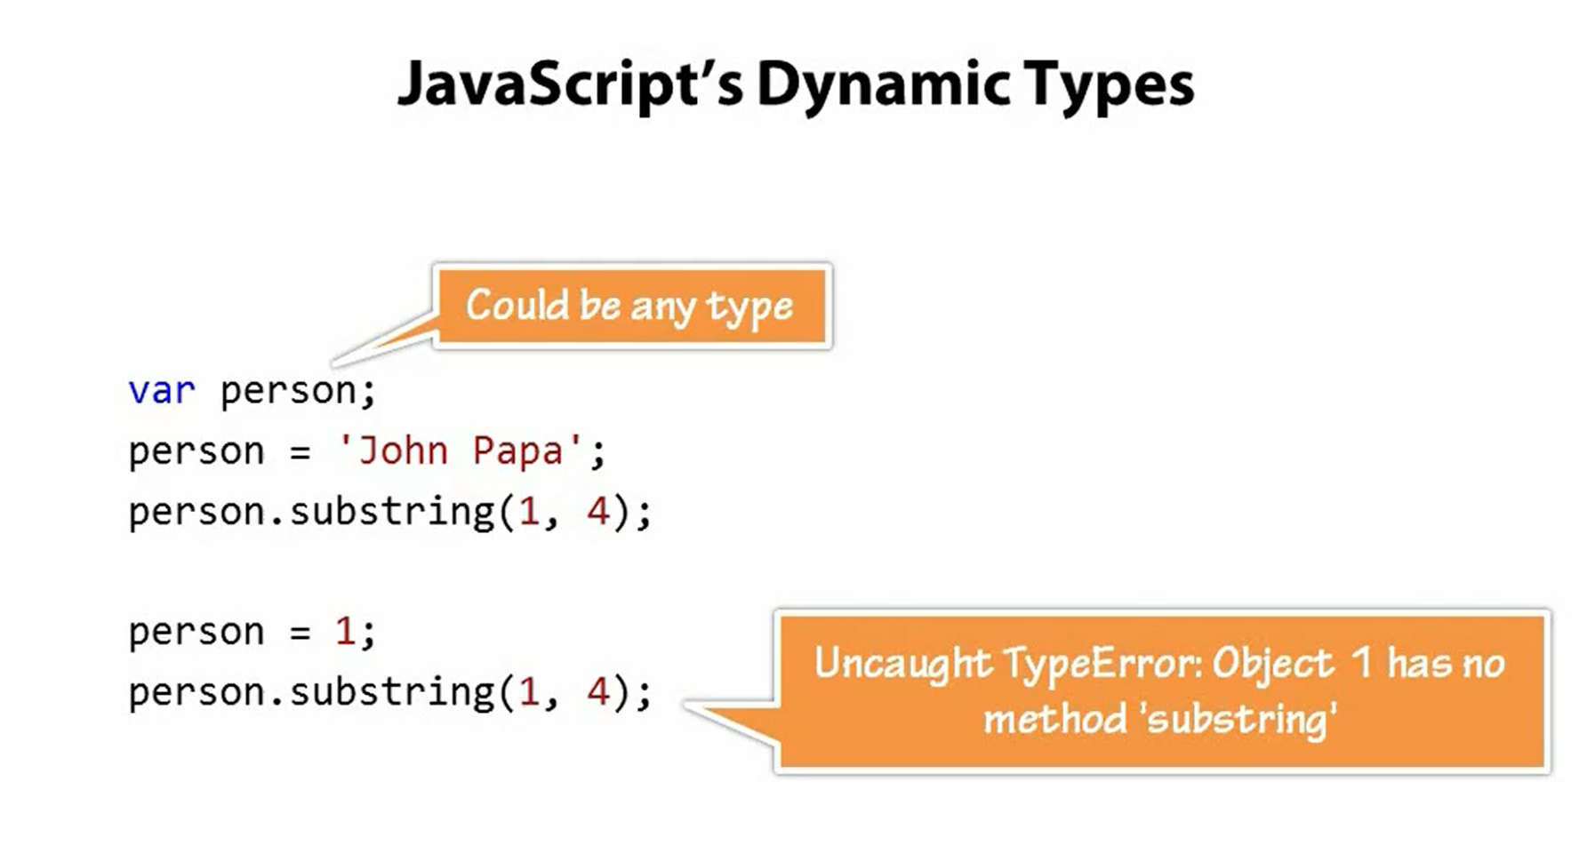

Slide 25
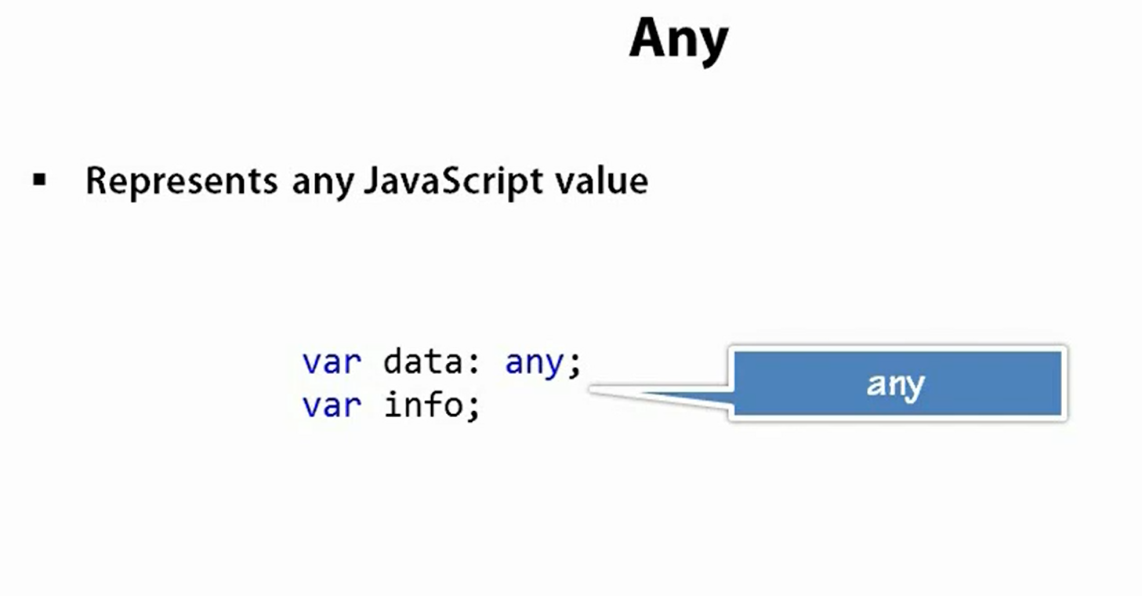
The Any Type and Premitives
Any data type can represent any Javascript value.

Slide 26
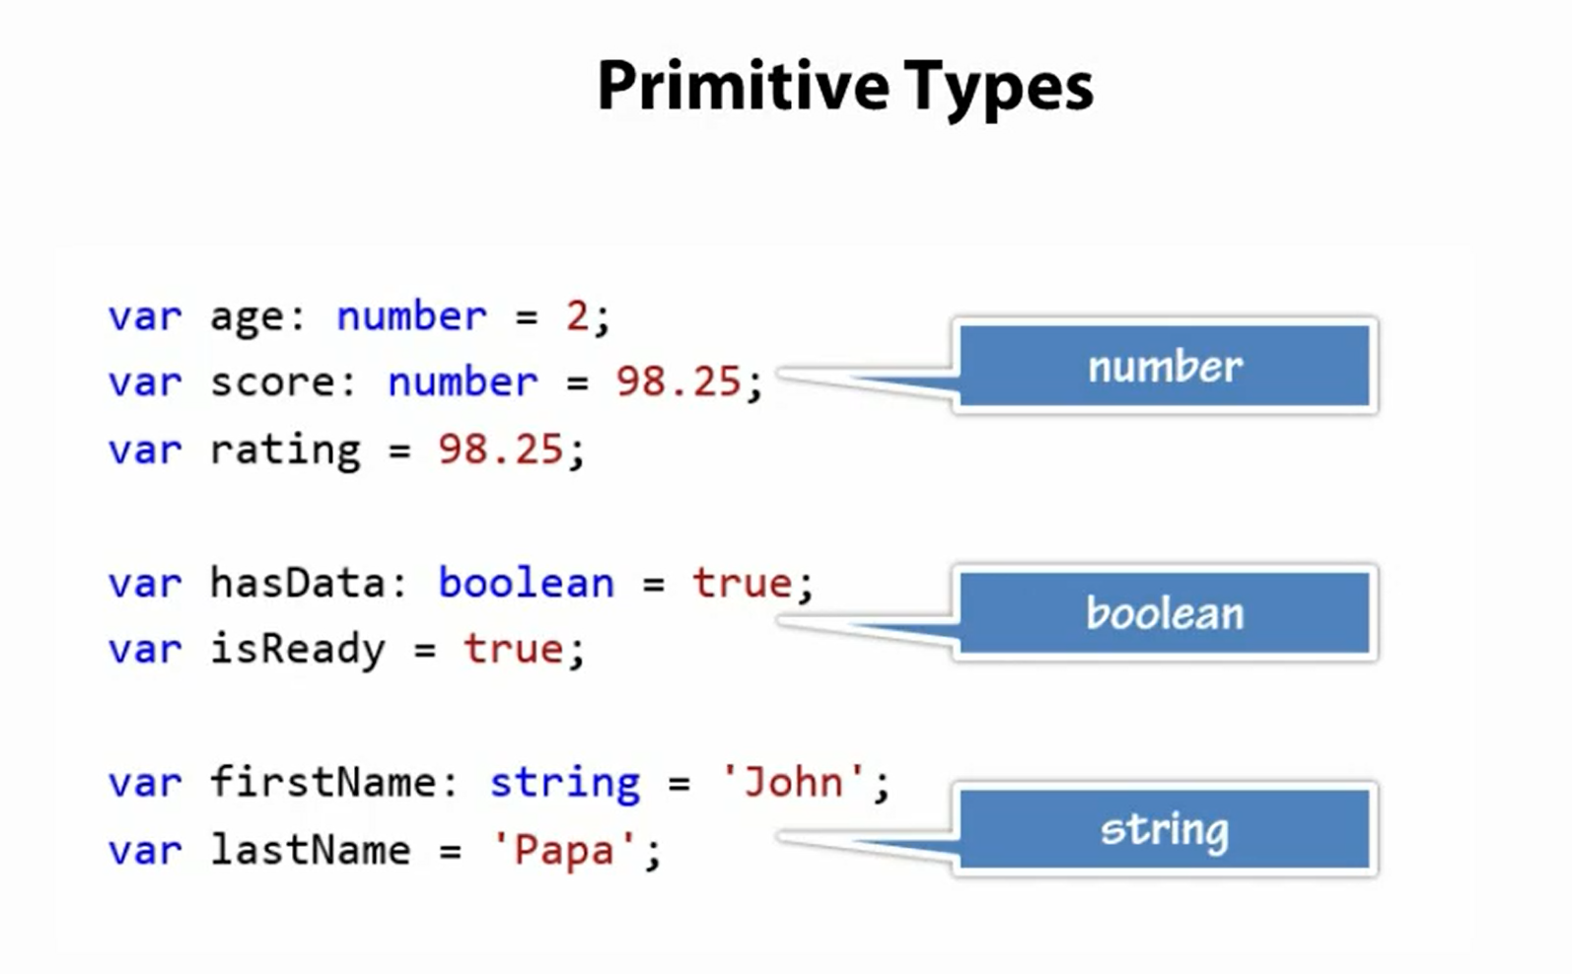

Slide 27
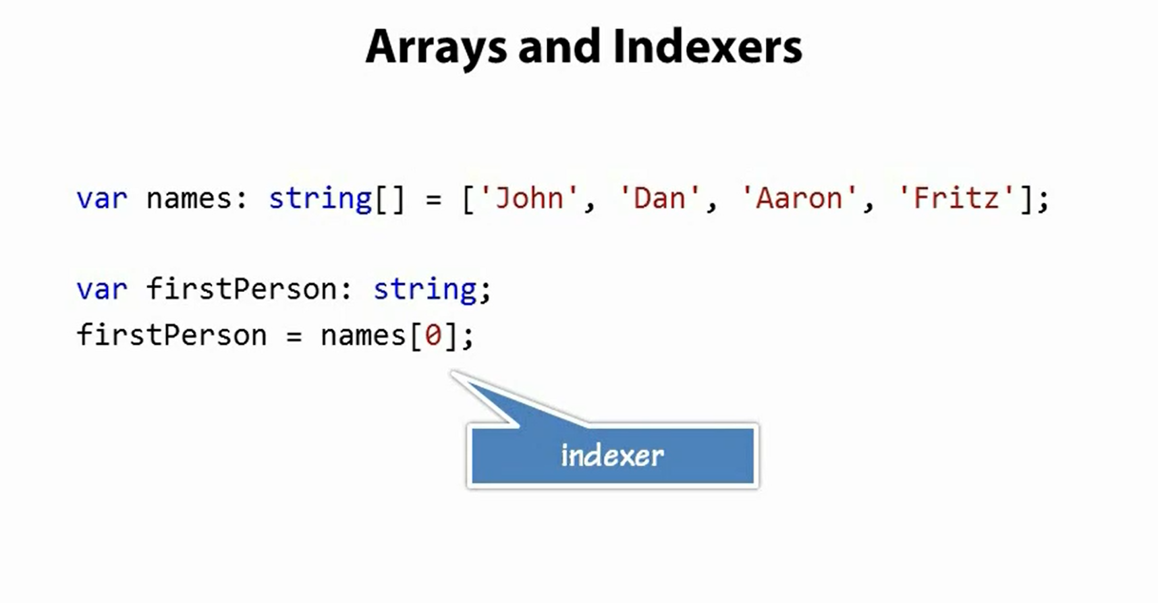

Slide 28
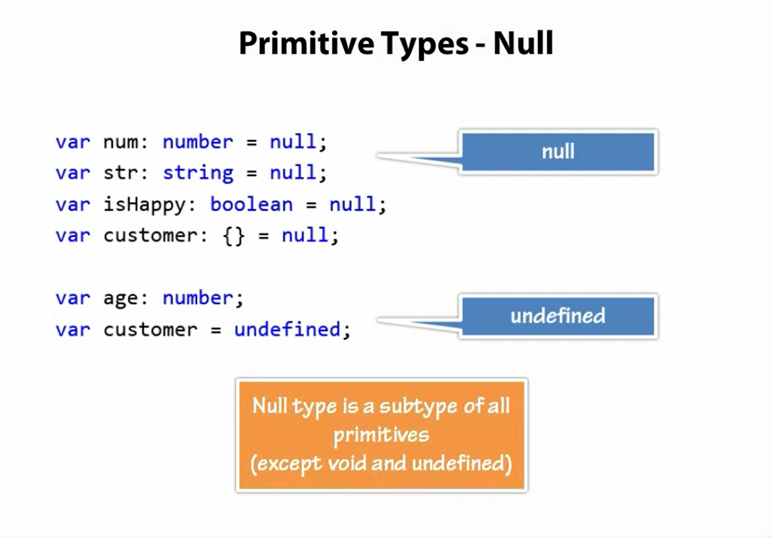

Slide 29
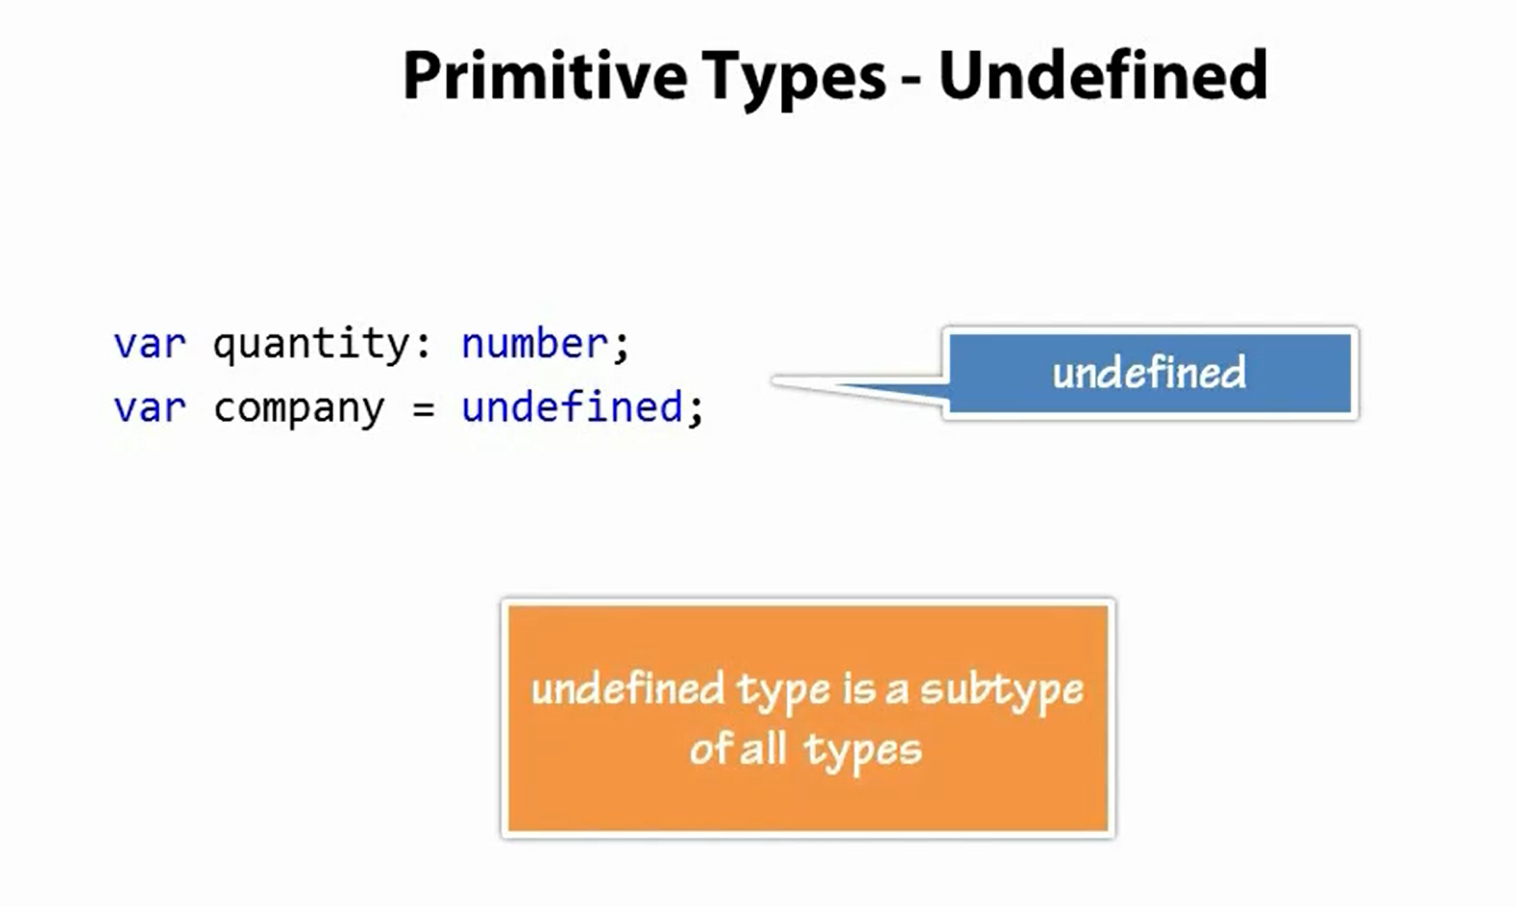

Slide 30
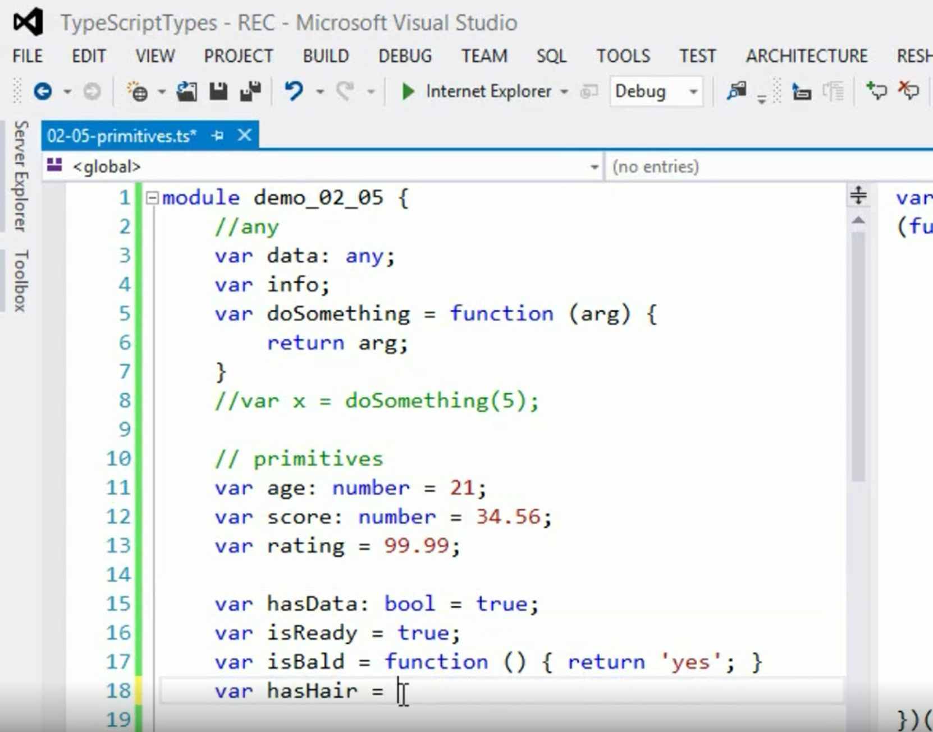
Primitive Types : Demo

Slide 31
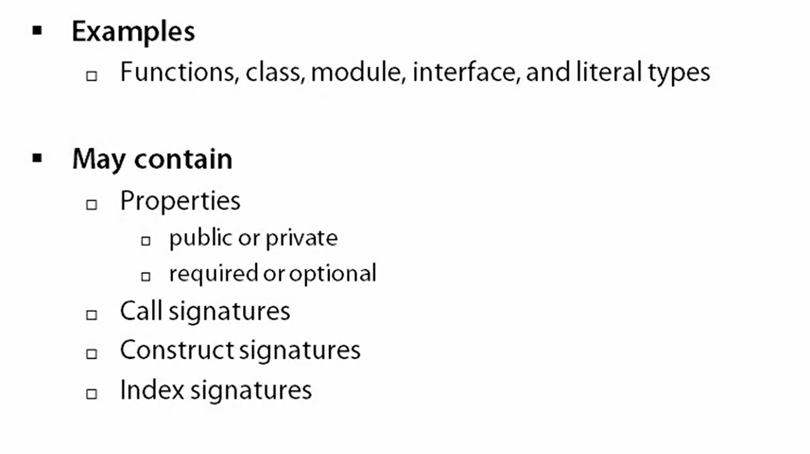
Object Types

Slide 32
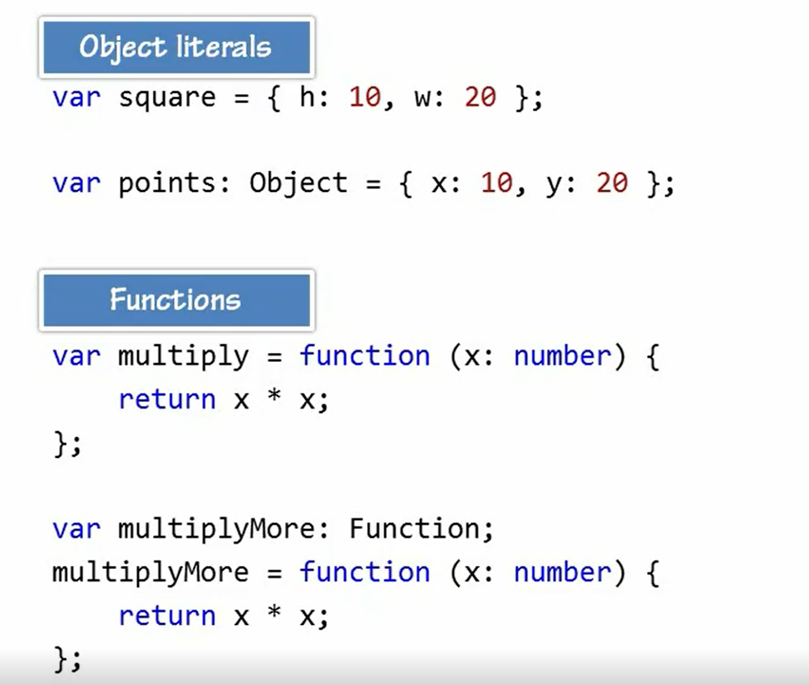

Slide 33
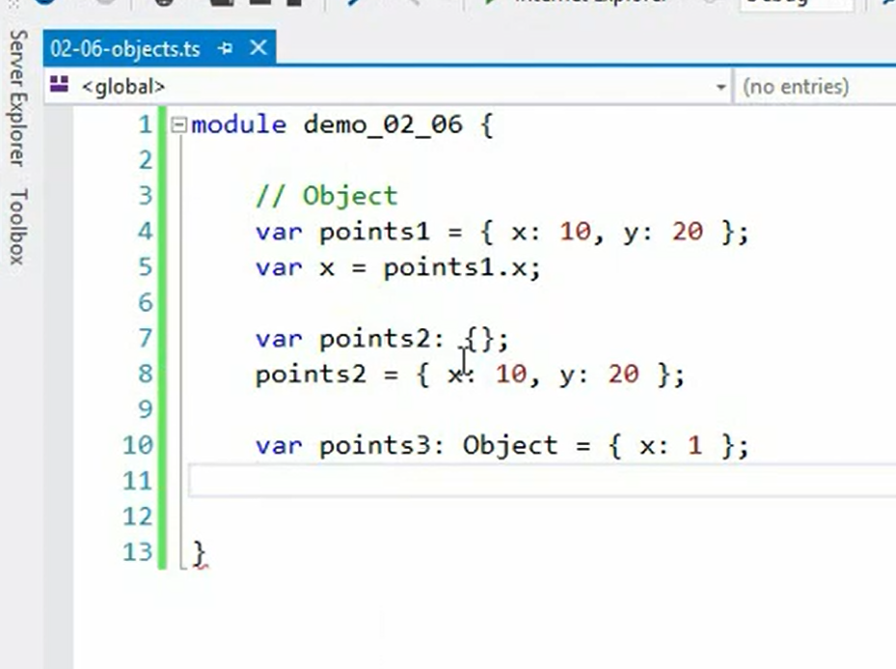

Slide 34
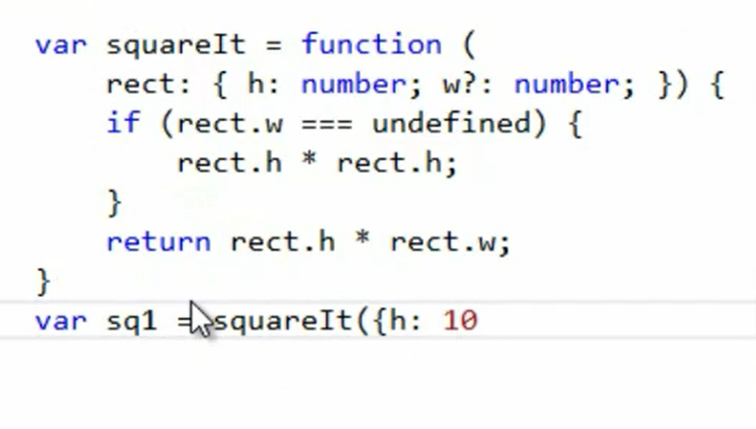

Slide 35
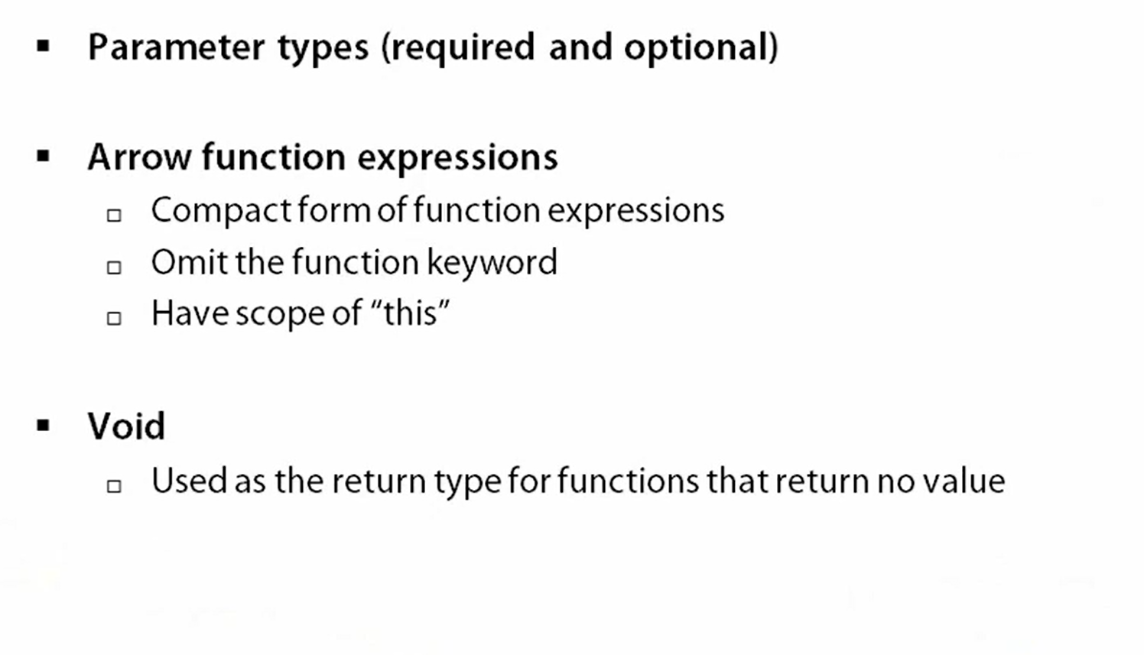
Functions

Slide 36
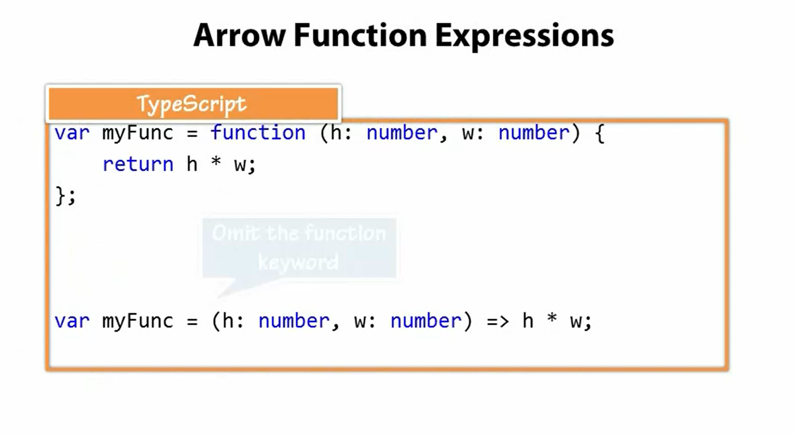

Slide 37
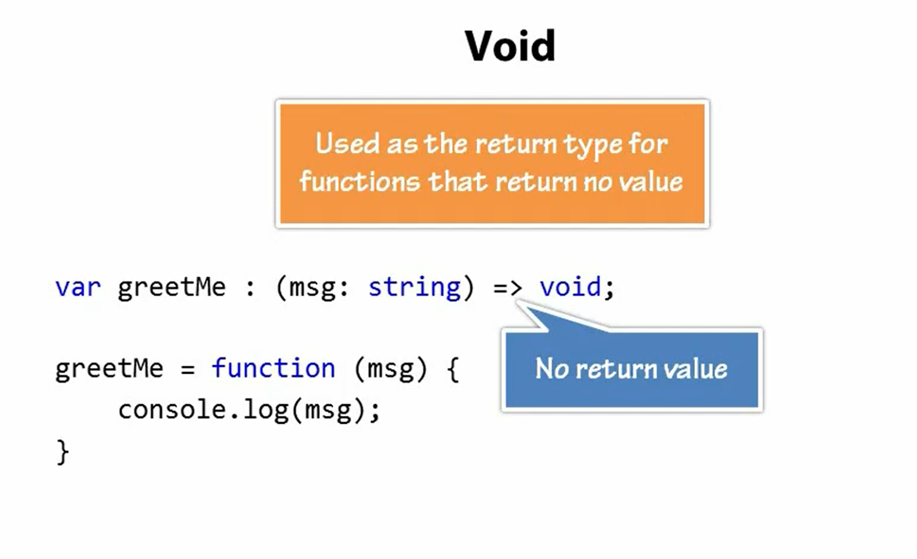

Slide 38
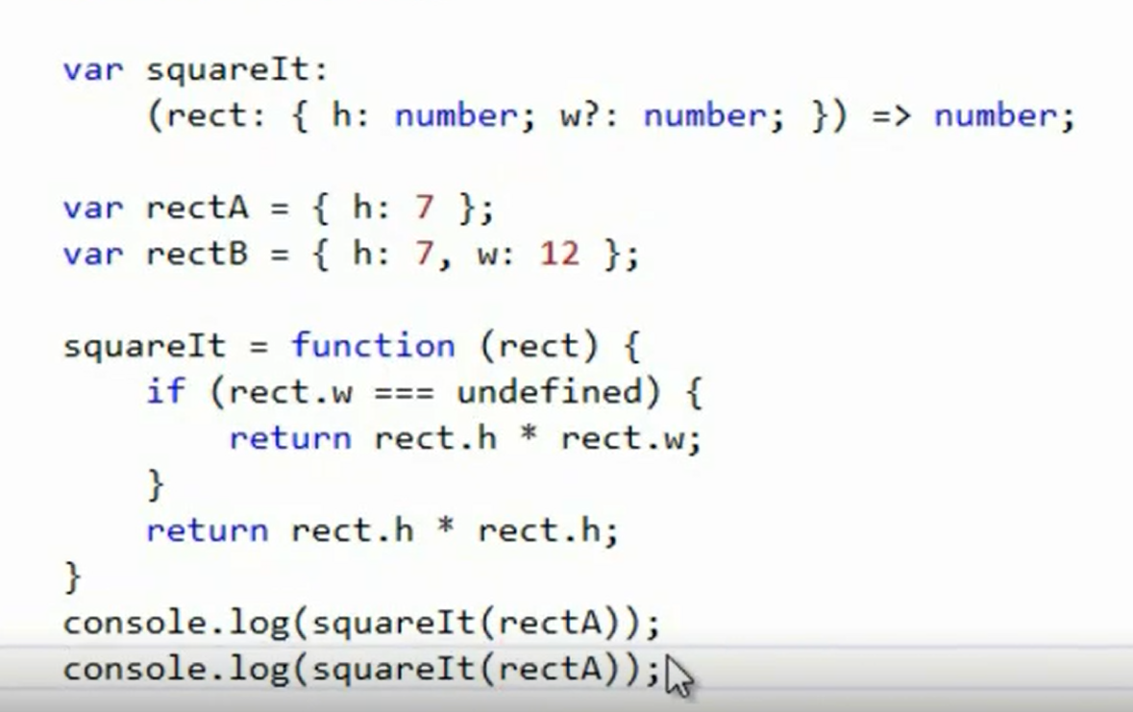
Functions | Demo

Slide 39
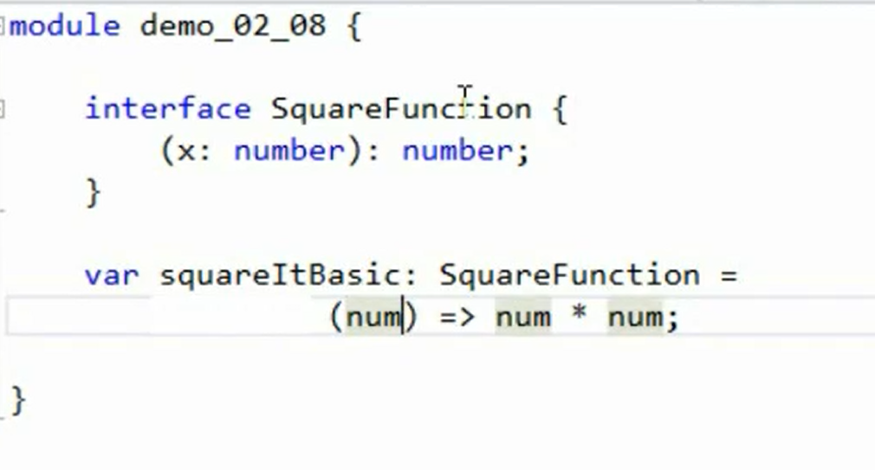
Functions and Interfaces
Notes:
To show the advantage of using interface add one more parameter called Foo to the function signature and VS will show error.

Slide 40
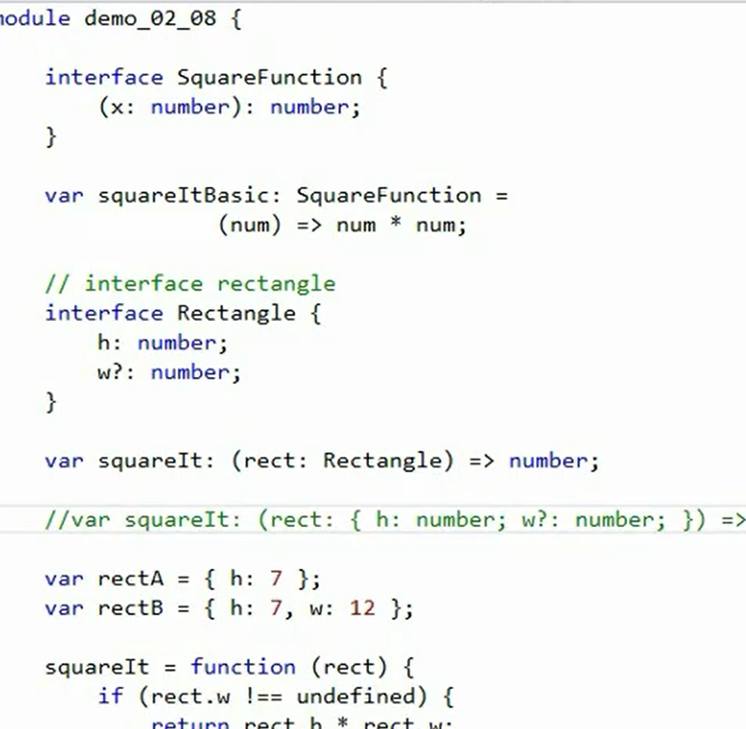

Slide 41
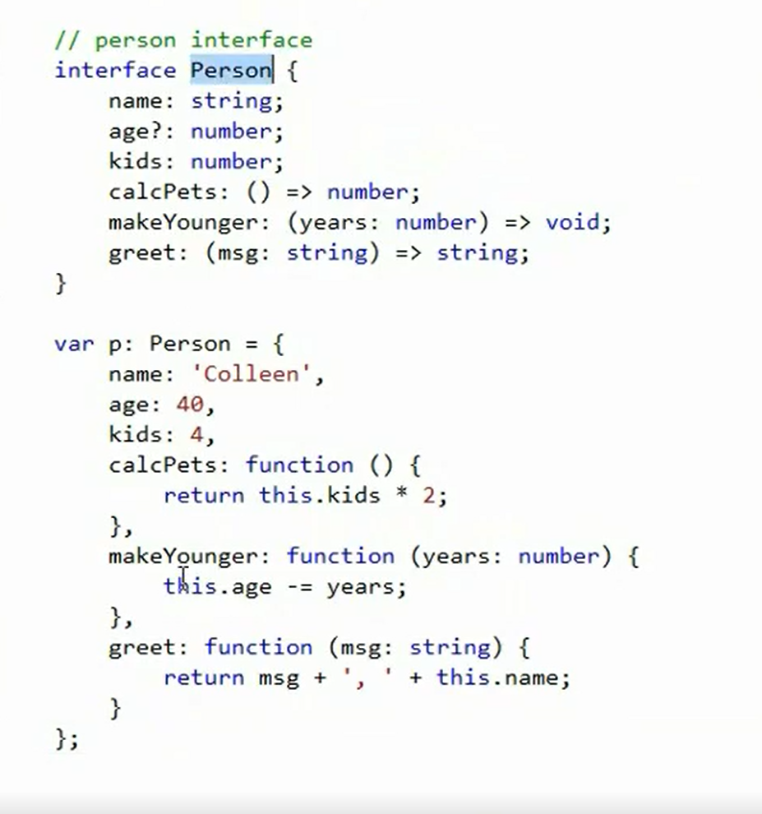
Notes:
To show the advantage of using interface add one more parameter called Foo to the function signature and VS will show error.

Slide 42
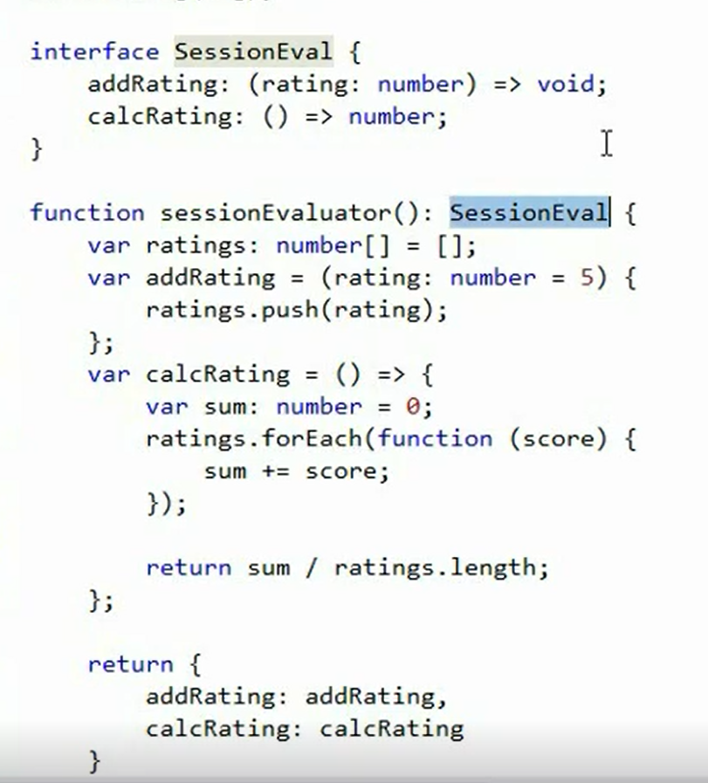
Interface to enforce return types

Slide 43
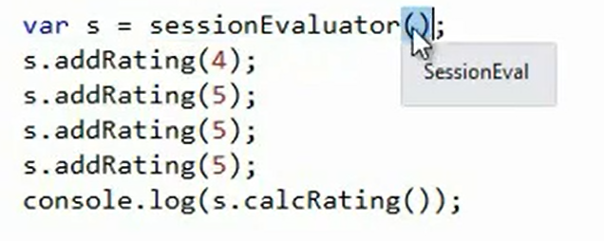

Slide 44
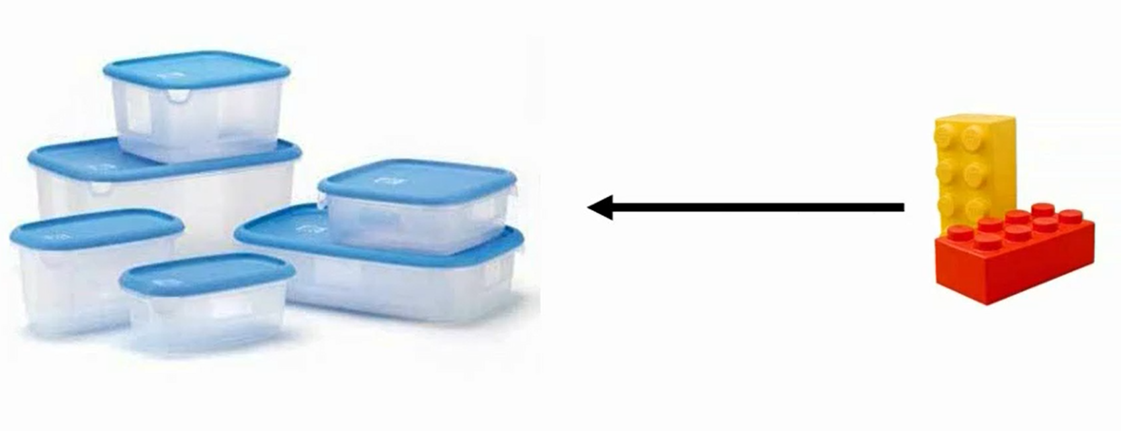
Classes and Interfaces
Typescript provides built-in support for classes
Class is just a container, it encapsulates code which can be reused

Slide 45
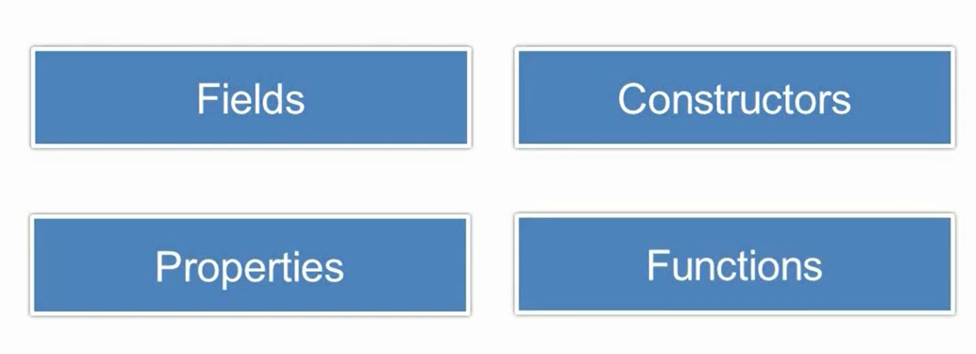
Class Members

Slide 46
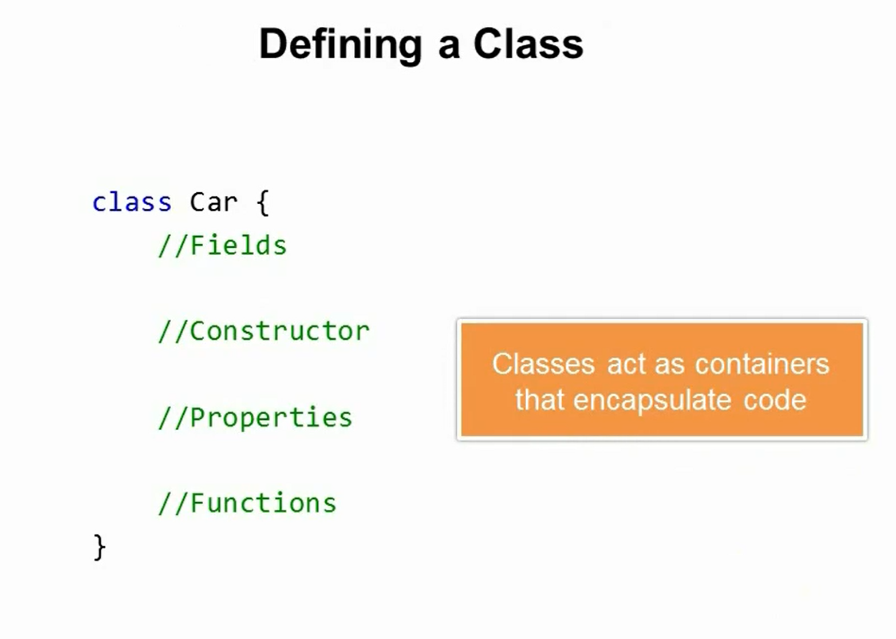

Slide 47
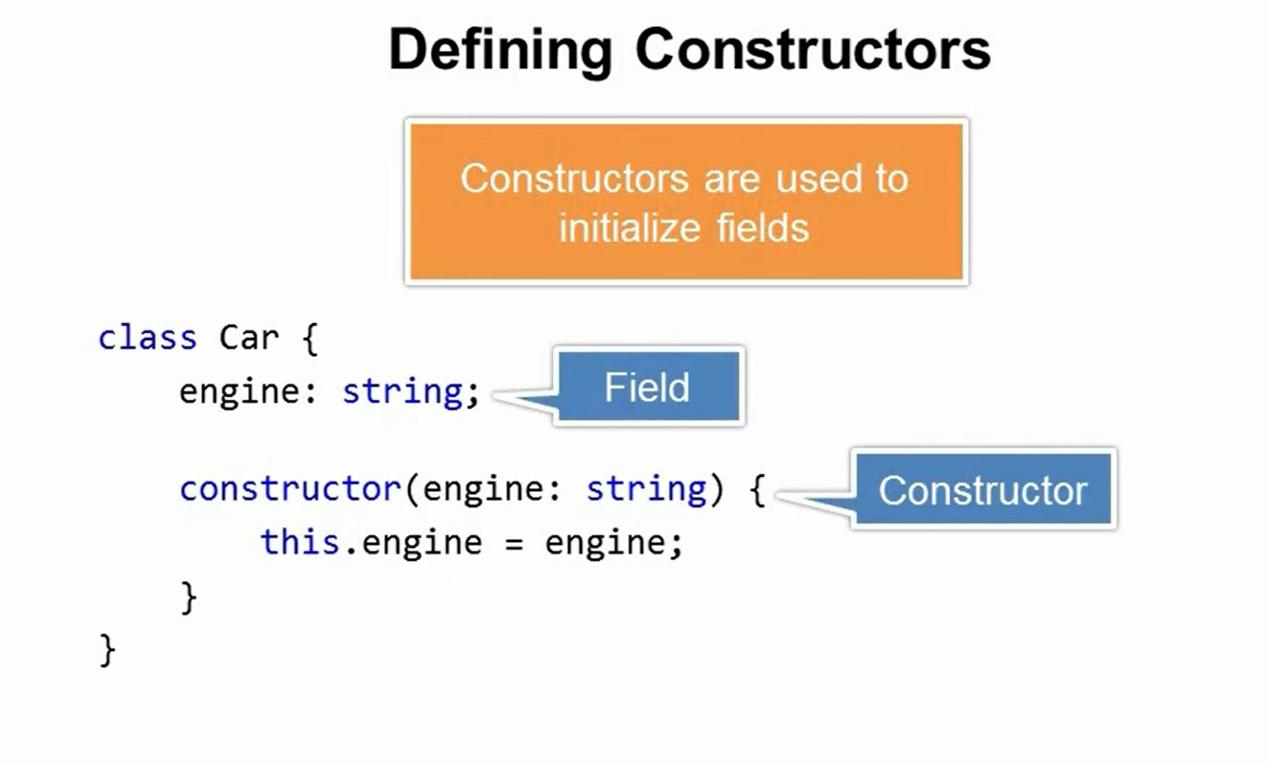

Slide 48
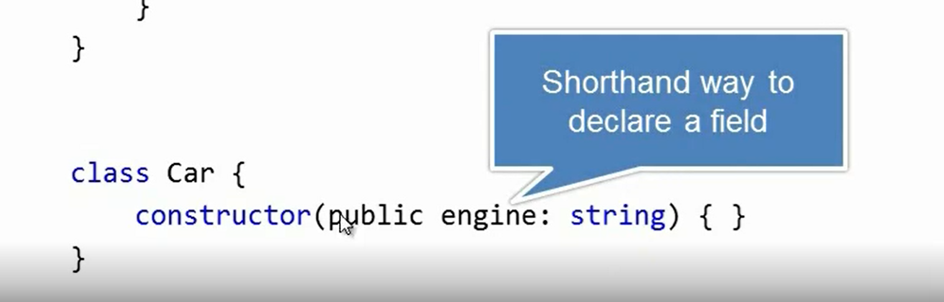

Slide 49
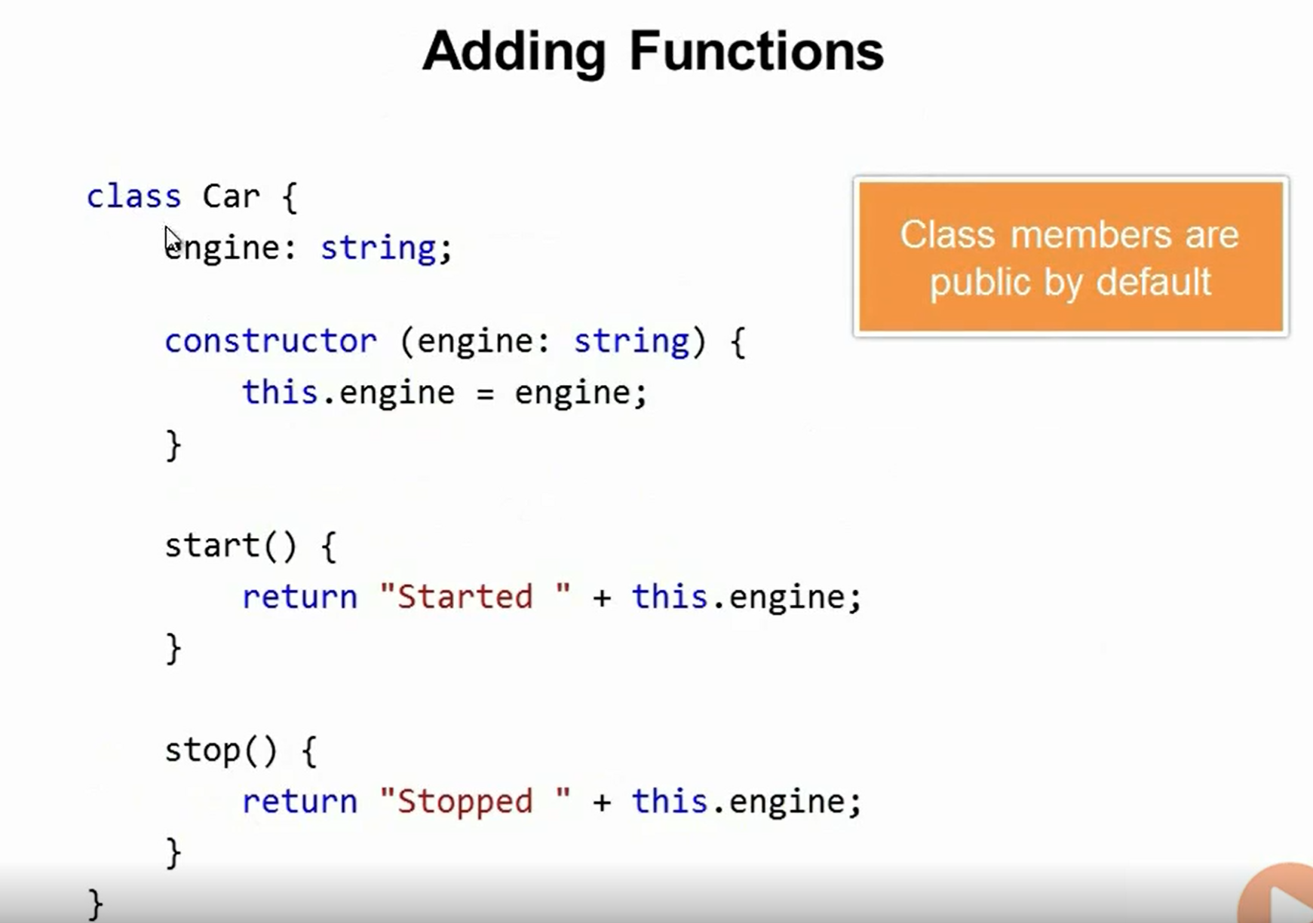

Slide 50
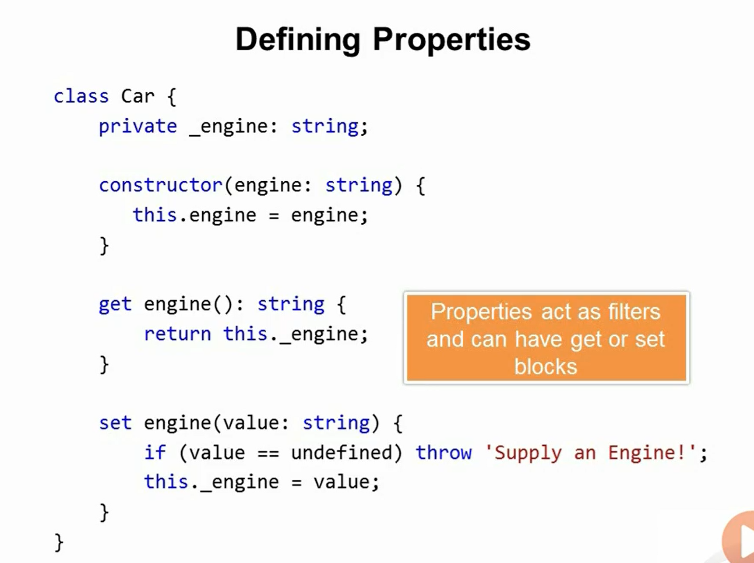

Slide 51
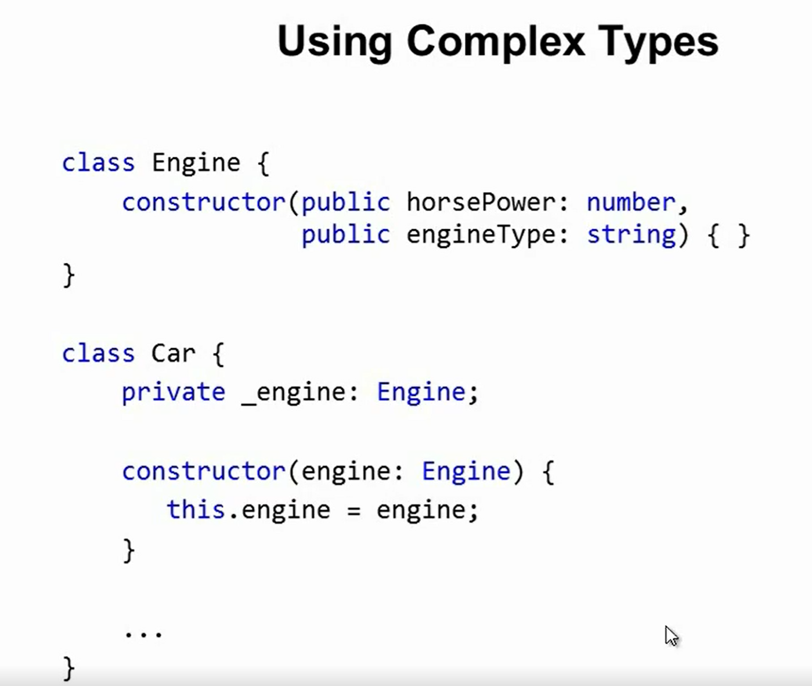

Slide 52
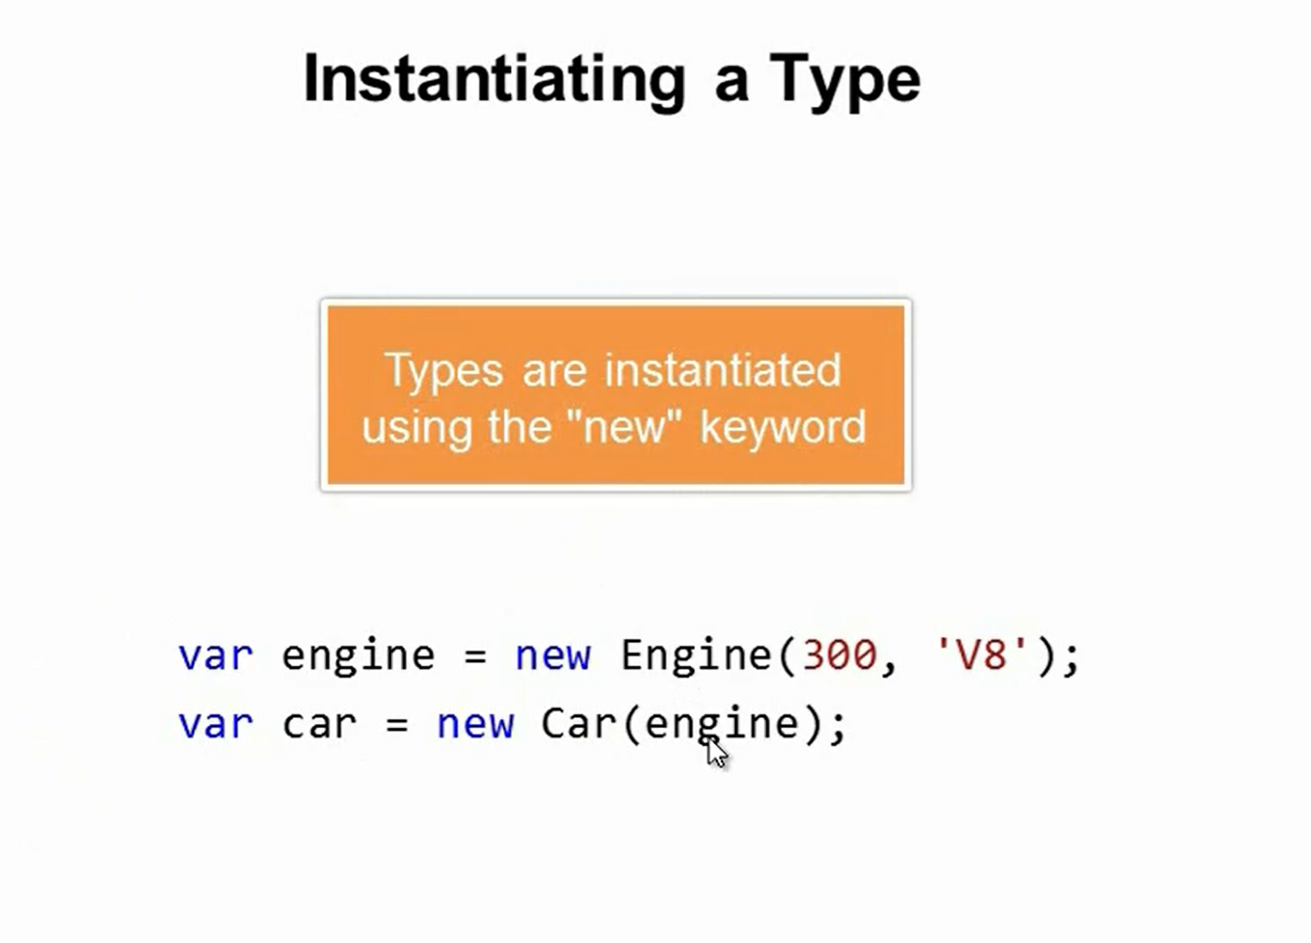

Slide 53
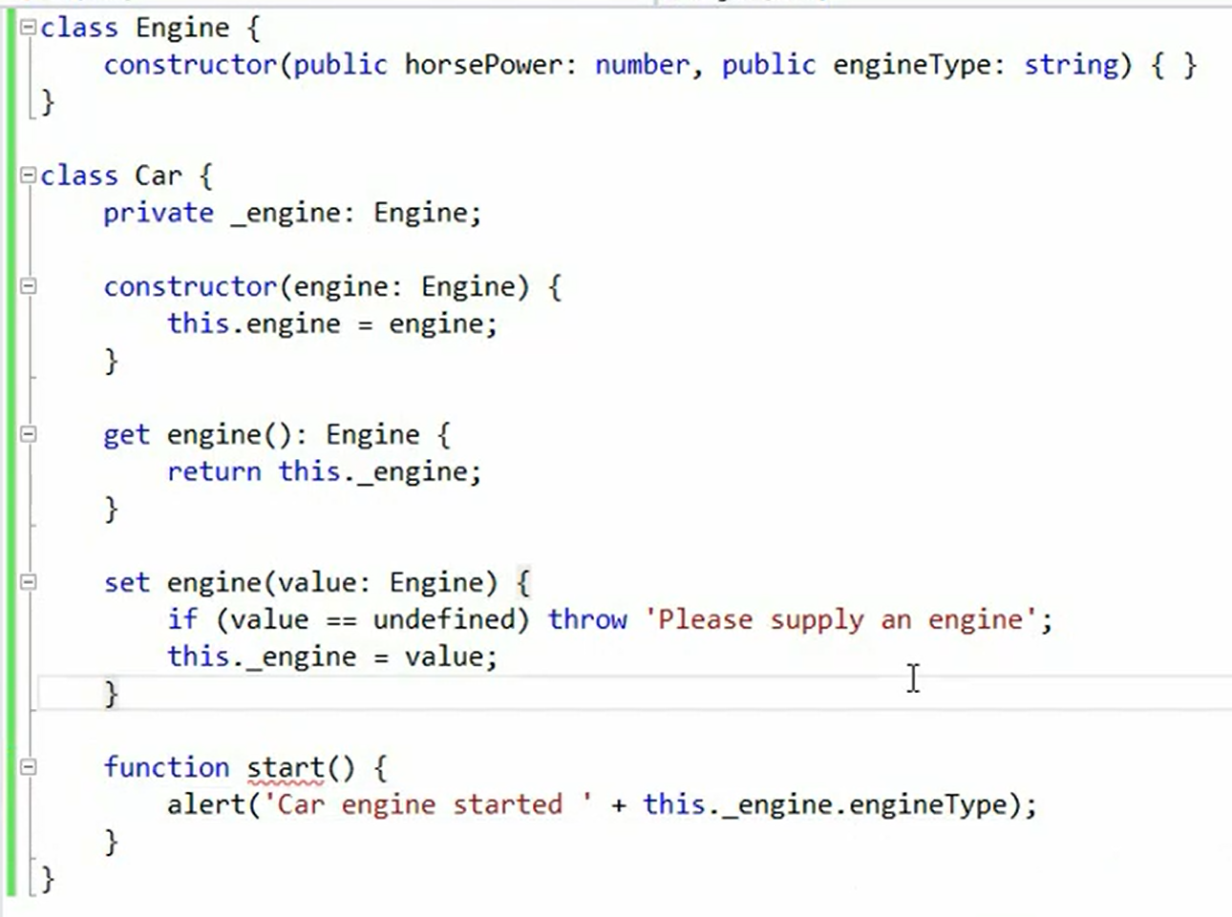

Slide 54
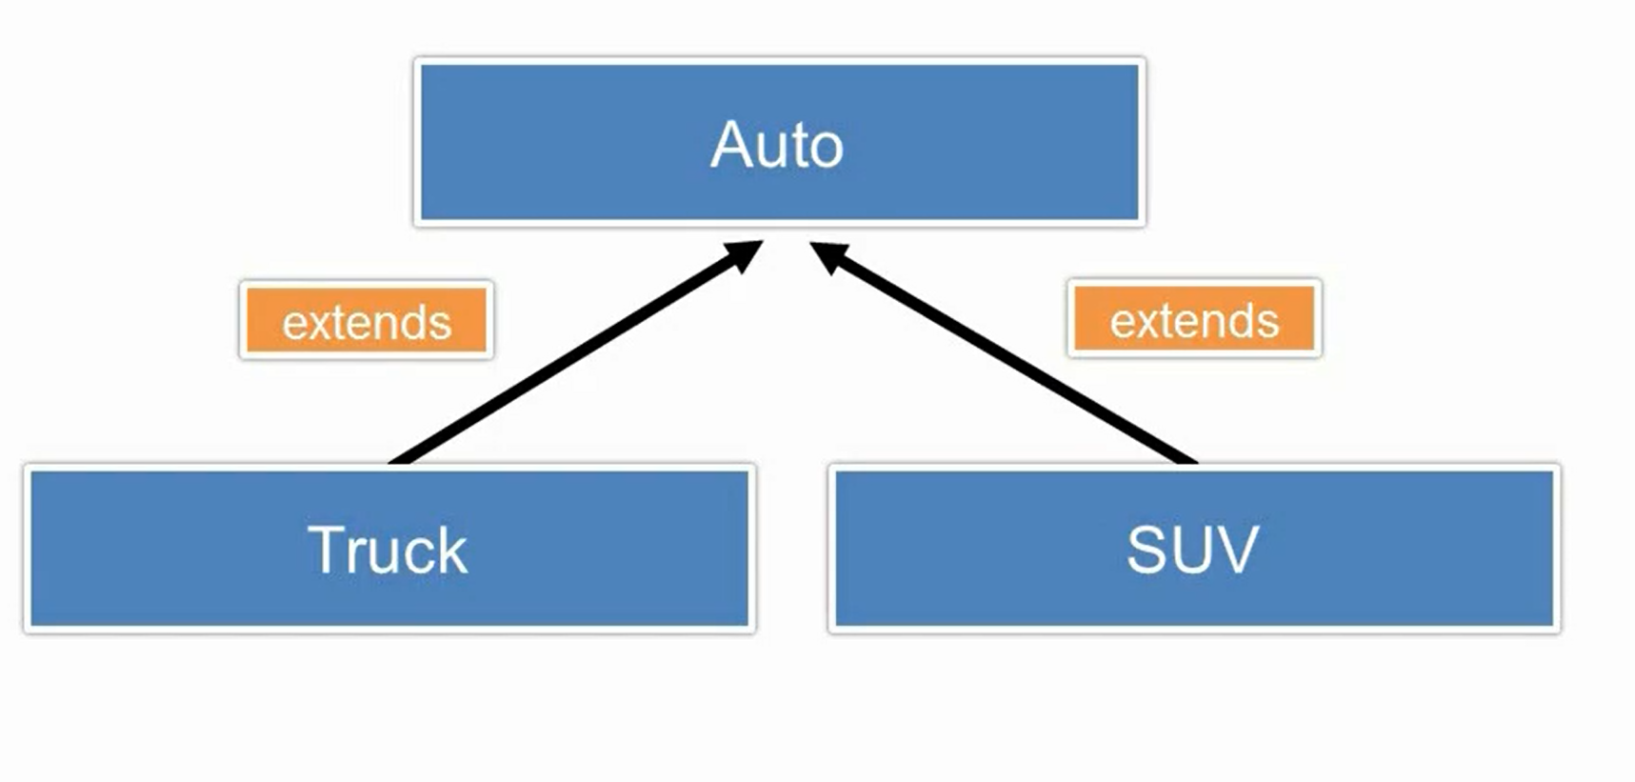
Extending Types

Slide 55
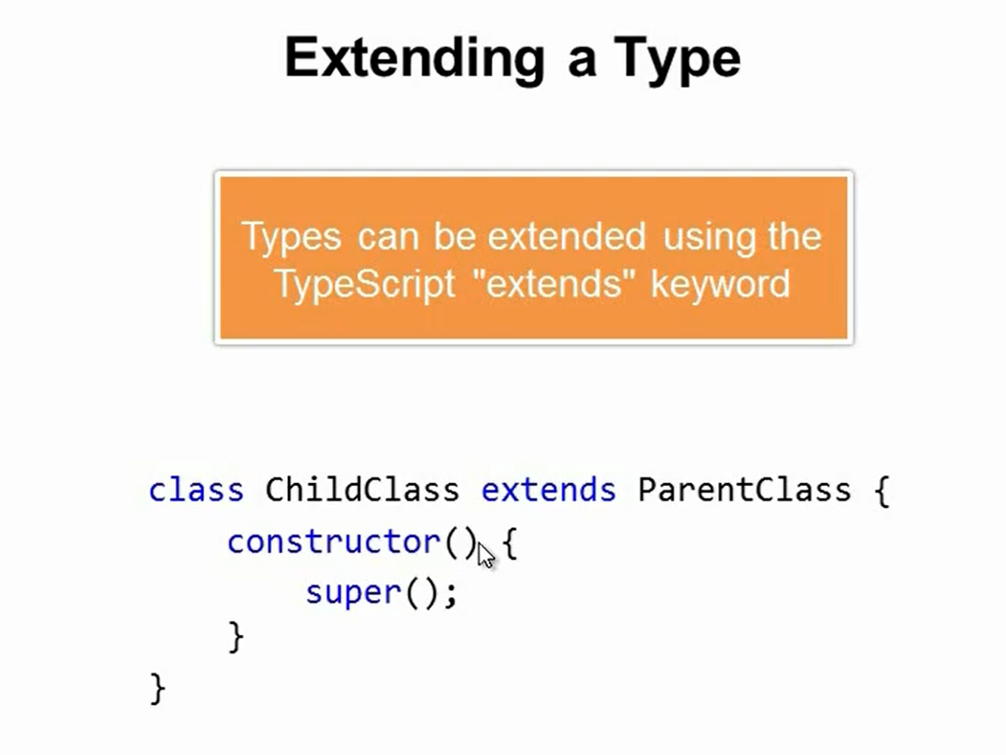

Slide 56
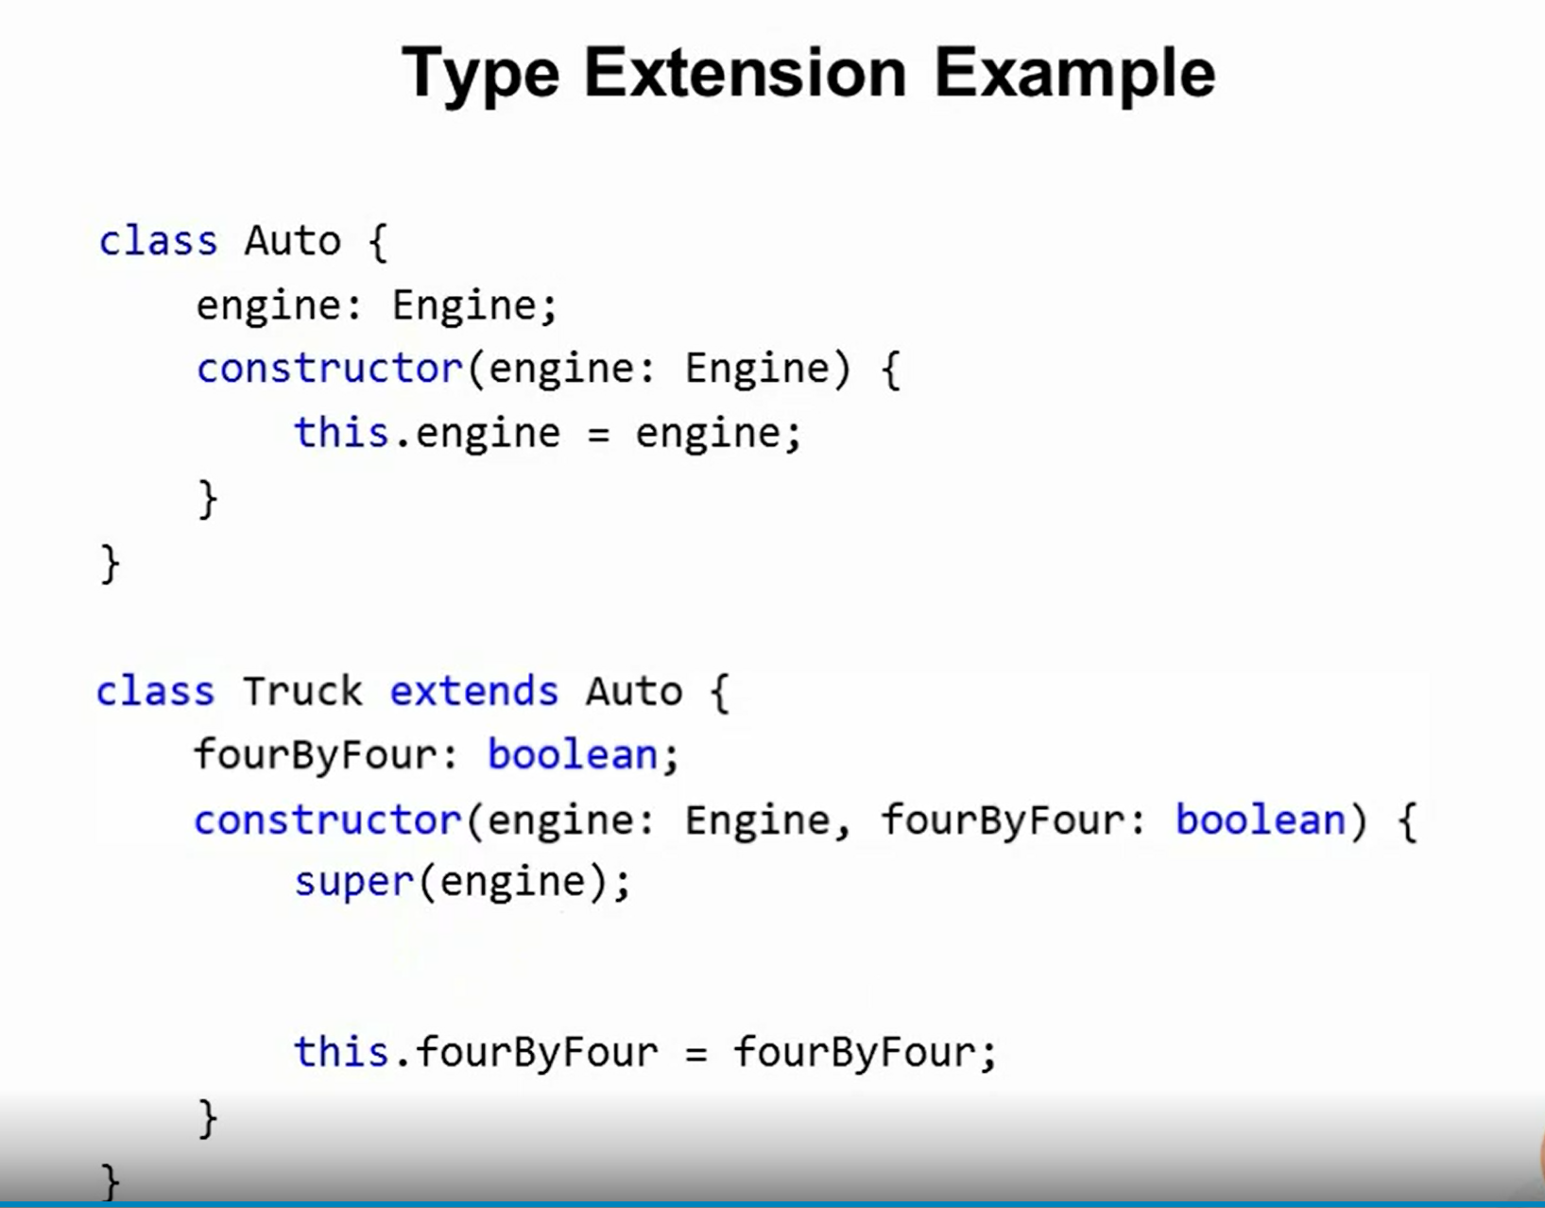

Slide 57
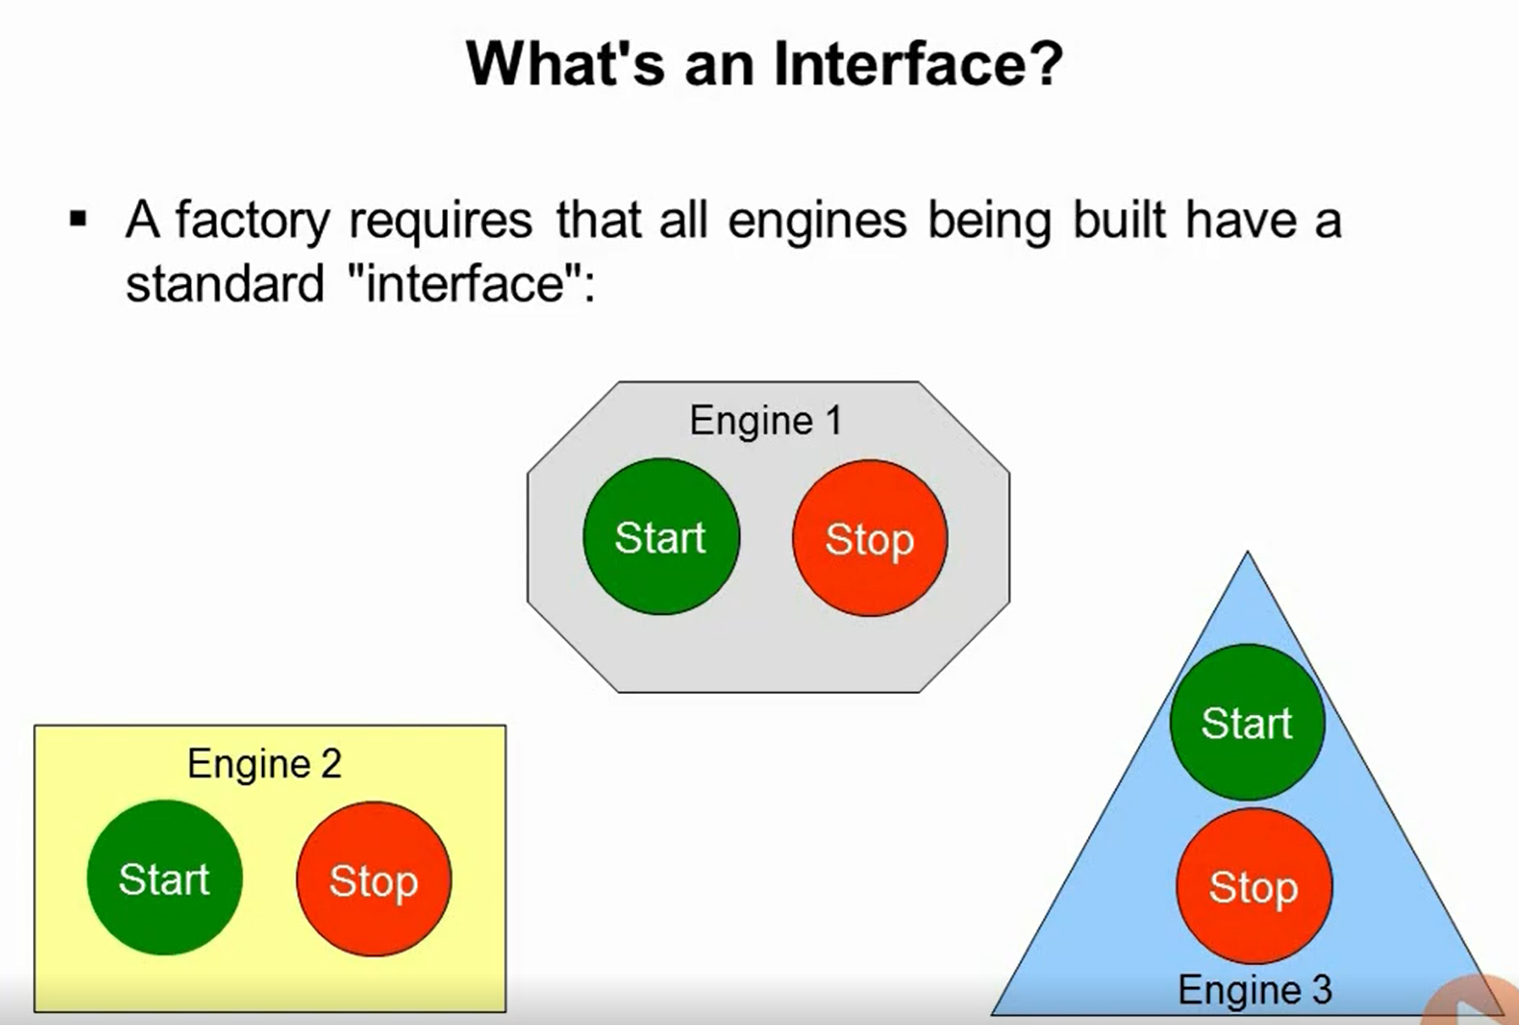
Using Interfaces

Slide 58
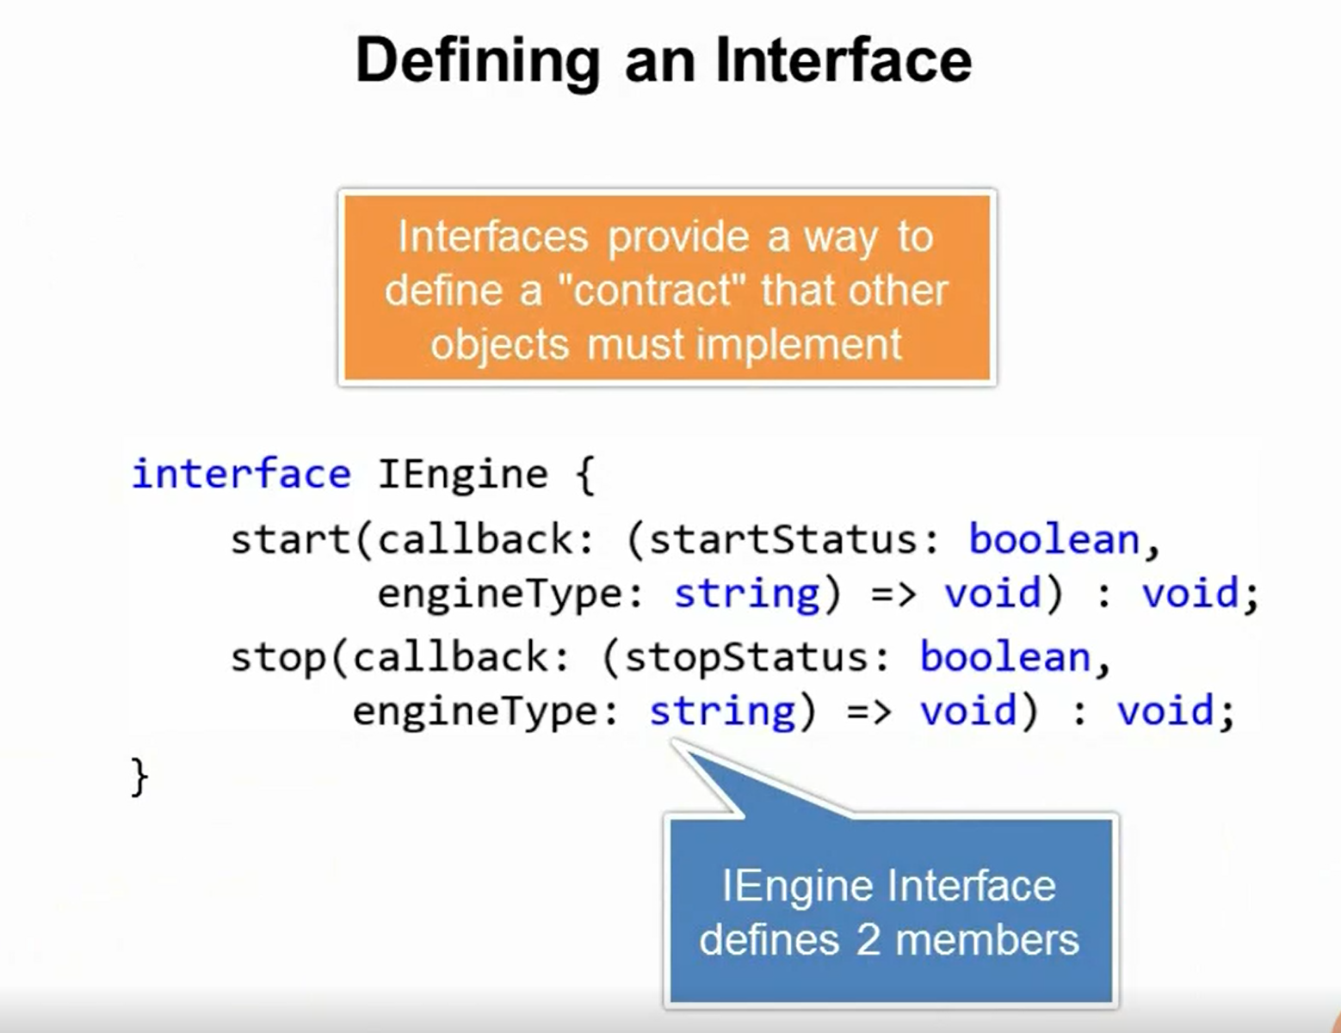

Slide 59


Slide 60


Slide 61


Slide 62


Slide 63

Extending Interfaces

Slide 64


Slide 65

Modules
Help you organize a large application into small groups

Slide 66


Slide 67


Slide 68


Slide 69


Slide 70


Slide 71


Slide 72


Slide 73


Slide 74

External Modules and Large Applications

Slide 75
Demo | External Modules
Create a simple Alerter interface.
Create a class implementing Alerter interface.
Create a simple DataService interface.
Create a class implementing DataService interface.
Create a class bootstrapper which calls Alerter’s showMessage method.
Create a file called main.ts which will load all modules using require.js.
Refer require.js along with path to main module in your html file.

Slide 76

Importing 3rd Party Libraries

Slide 77

Importing 3rd Party Libraries

